Slide 1
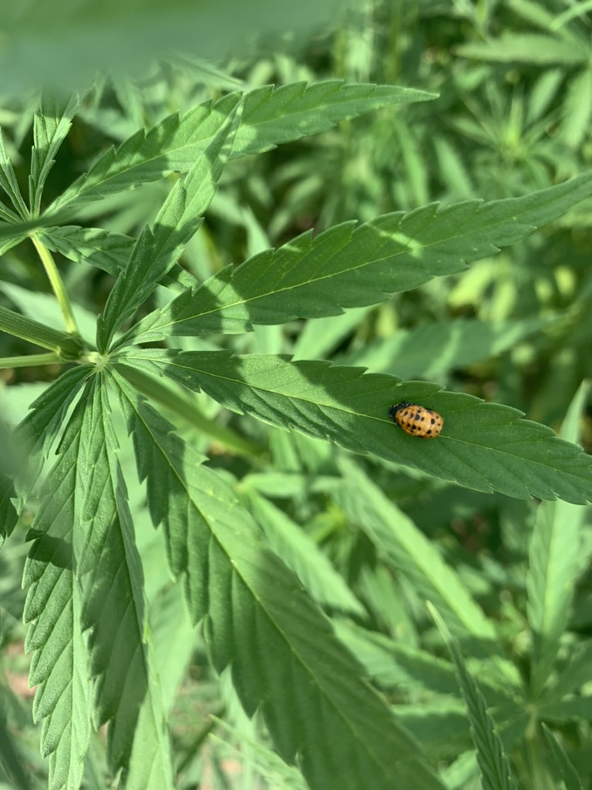

THE DECOMPOSITION OF FIBER HEMP RESIDUES IN THE SOIL
Lithuanian Research Centre for Agriculture and Forestry
Phd Student Urtė Stulpinaitė,
prof. Vita Tilvikienė,
prof. Monika Vilkienė

Slide 2
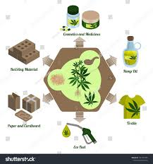
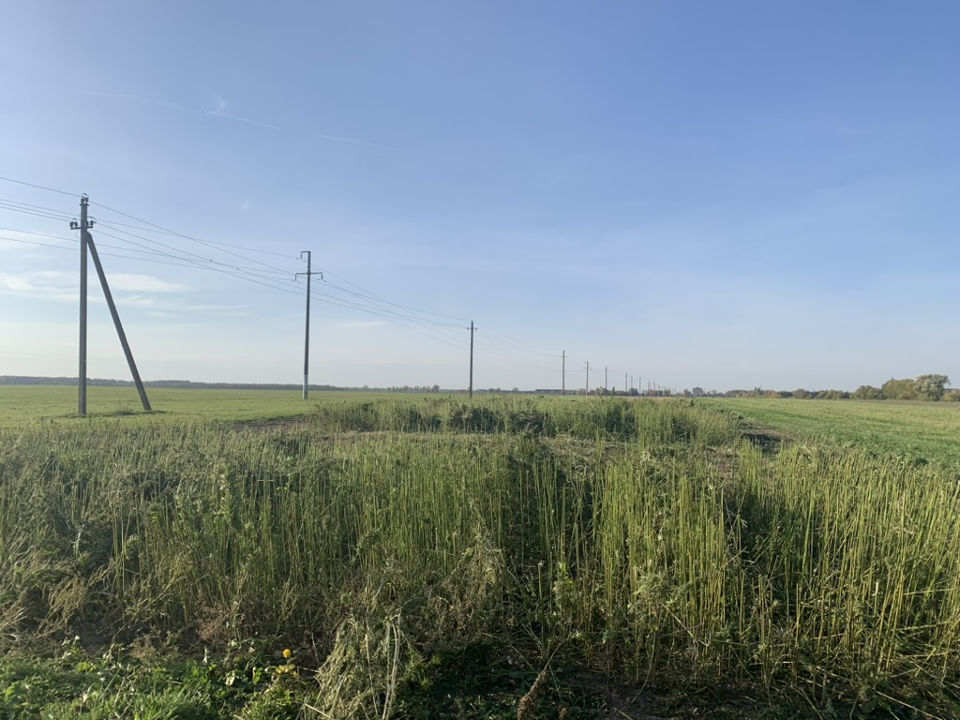
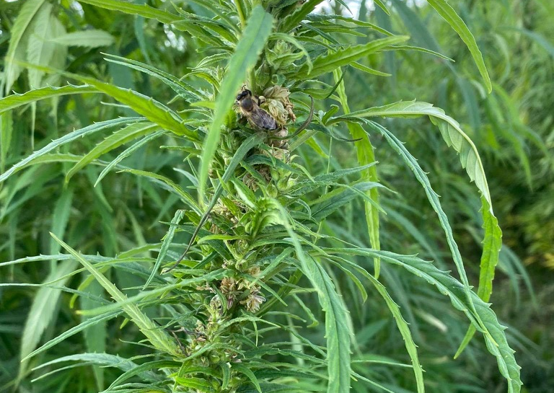

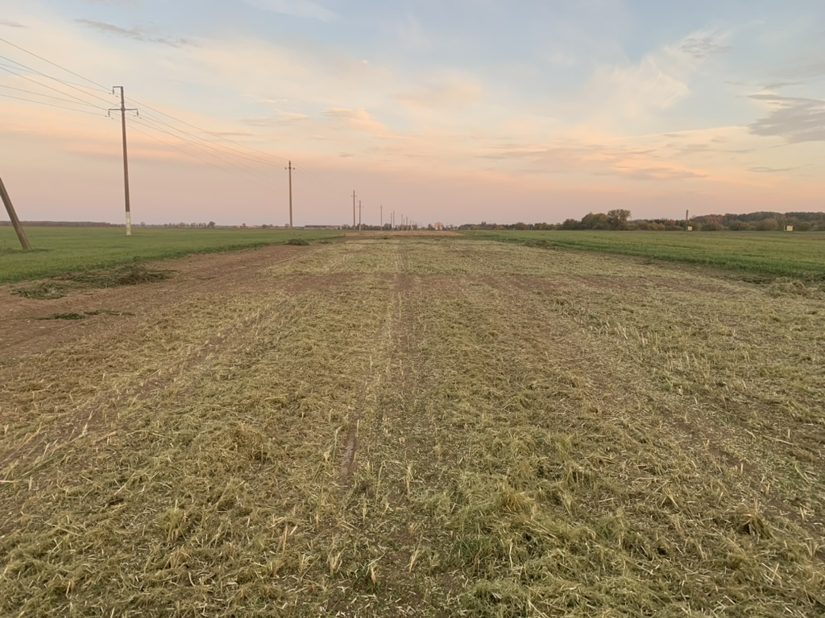


Slide 3

The aim of this study – Determine the rate of decomposition of hemp residues
15 g of hemp residues is putting in nylon bags
TREATMENTS​
RA - Hemp residues to plow on Autumn;​
RS - Hemp residues to plow early spring;​
NE - Hemp residues left on the soil, no tillage.
54 Nylon bags is leaving in the field since November according to the 3 treatments each treatment has 6 replicates.
Every month one bag for each treatment is taking and measurement the weight of the bag​.

Slide 4
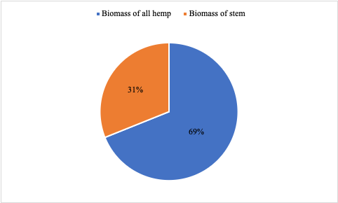
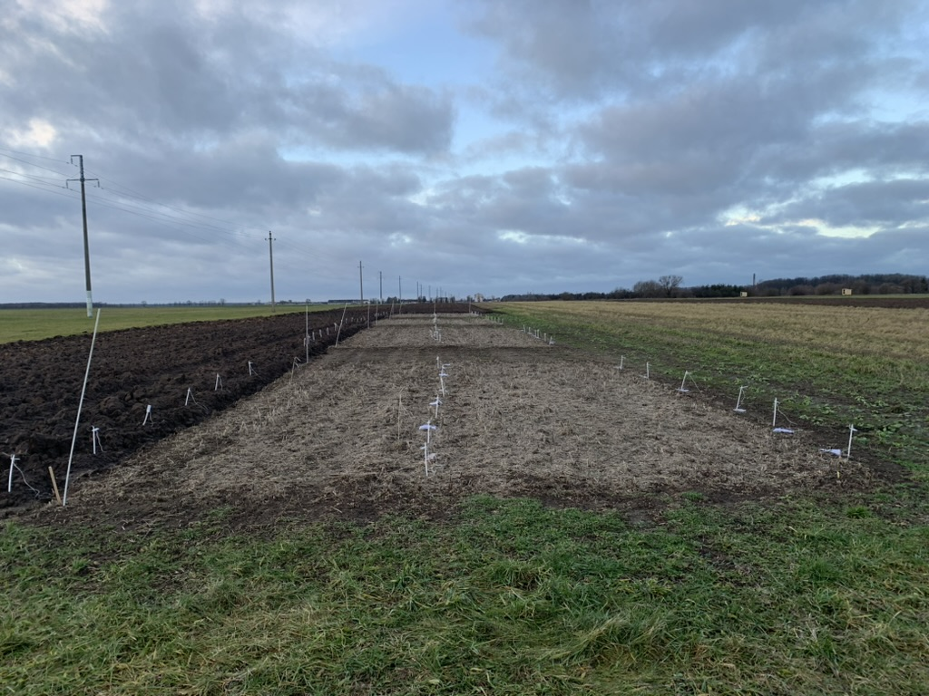
Hemp biomass – 14 t/ha,
Hemp residues – 6,5 t/ha
Fig. 1 Hemp biomass and residues

Slide 5
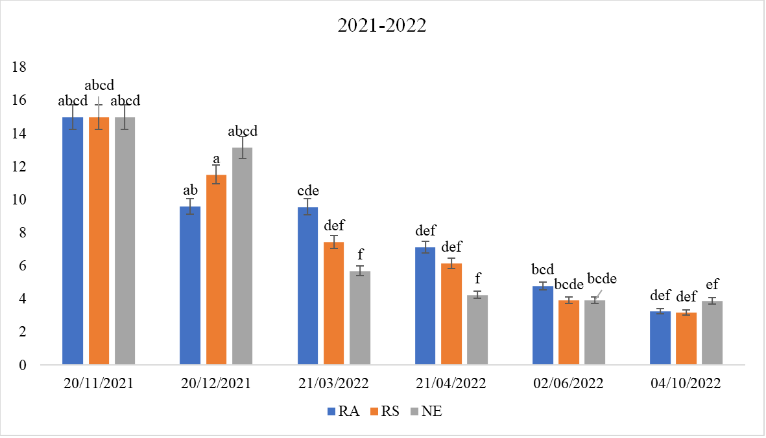
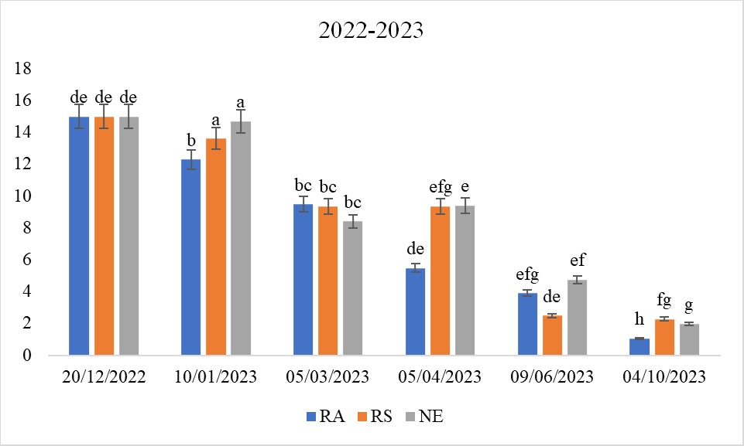
Hemp residuese decomposition rate
Fig. 2 Hemp residues mineralization in 2021-2022
Fig. 3 Hemp residues mineralization in 2022-2023

Slide 6
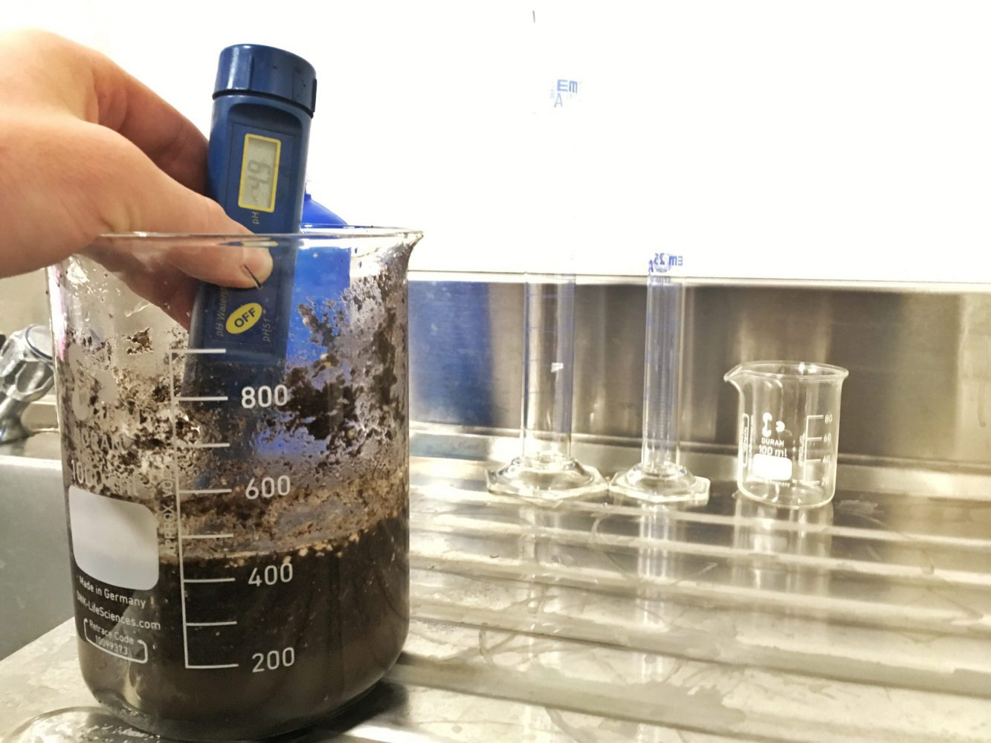
Table 1. Hemp residues influence for soil pH
￼ | pH |  | ￼ pH
￼ | before | after | before | after
Control | 5,63ns | 5,2ns | 5,12a | 4,26ab
RA | 5,53ns | 5,43ns | 5,02a | 4,12b
RS | 5,56ns | 5,74ns | 4,97ab | 4,26ab
NE | 5,67ns | 5,2ns | 5,06a | 4,83ab
p- value | 0,51ns |  | 5.02e⁻⁵***

Slide 7

Table 2. Nitrogen and Carbon in the soil before and after experiment in 2021-2022 and 2022-2023
 | N content before exp. % | N content after exp. % | C content before exp. % | C content after exp. %
Control | 0.23c | 0.23c | 0.95d | 1.79b
RA | 0.21c | 0.24c | 0.89d | 1.65c
RS | 0.22c | 0.21b | 0.95d | 1.60c
NE | 0.24c | 0.23a | 0.98d | 2.18a
Overall, we concluded, comparing the obtained results with the studies conducted by other scientists, that hemp residues can be used to improve soil quality, with a positive impact on the environment. However, the high amount of lignin in a plant waste can be a problem in residues decomposition, so it is necessary to use additional nitrogen to accelerate waste decomposition.
 | N content before exp. % | N content after exp.% | C content before exp. % | C content after exp. %
Control | 0.13b | 0.16b | 0.95c | 0.93c
RA | 0.13b | 0.14b | 0.89c | 1.01c
RS | 0.14b | 0.15b | 0.95c | 1.5b
NE | 0.14b | 0.23a | 0.97c | 2.75a

Slide 8
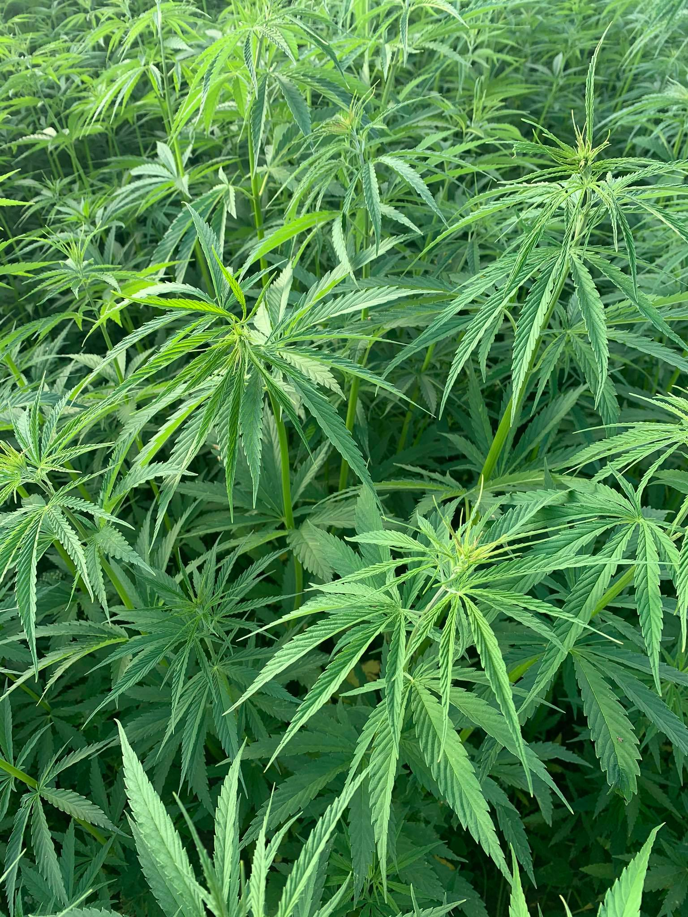
THANK YOU FOR
YOUR ATTENTION

