Slide 1

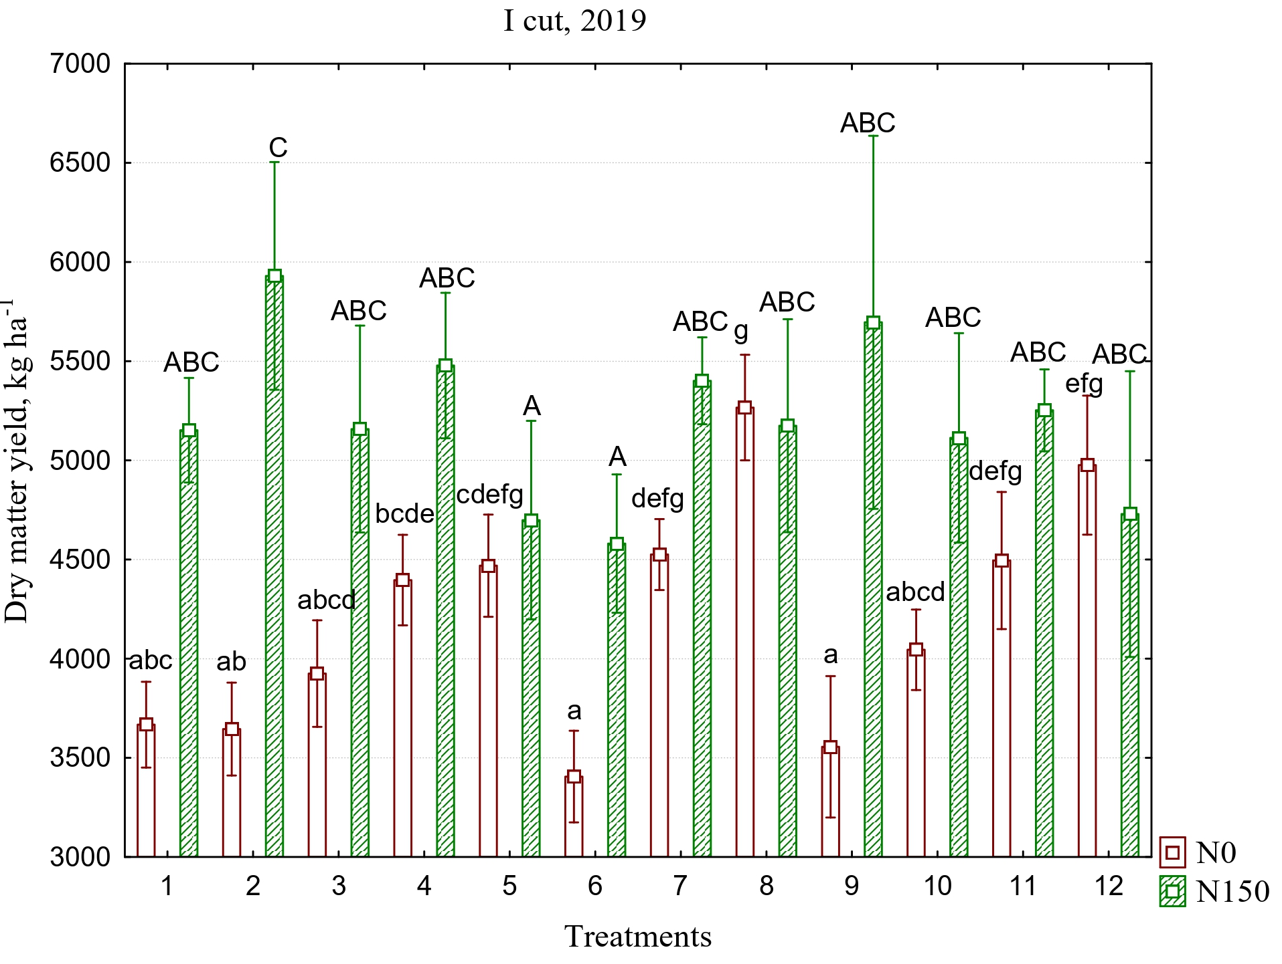
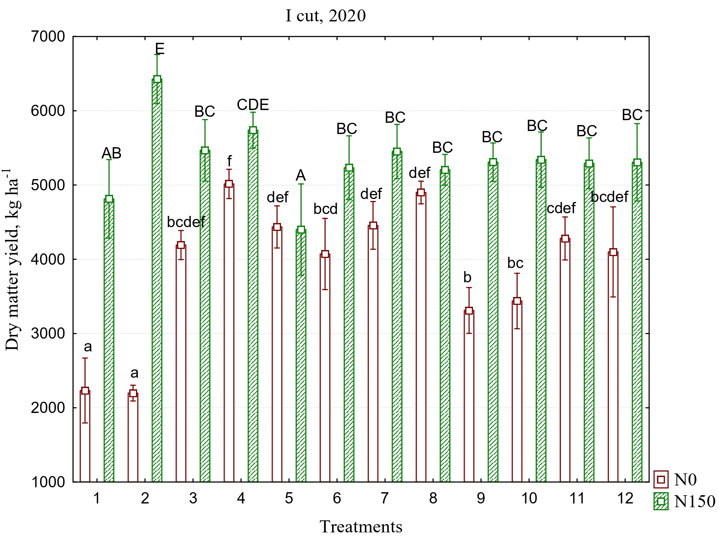
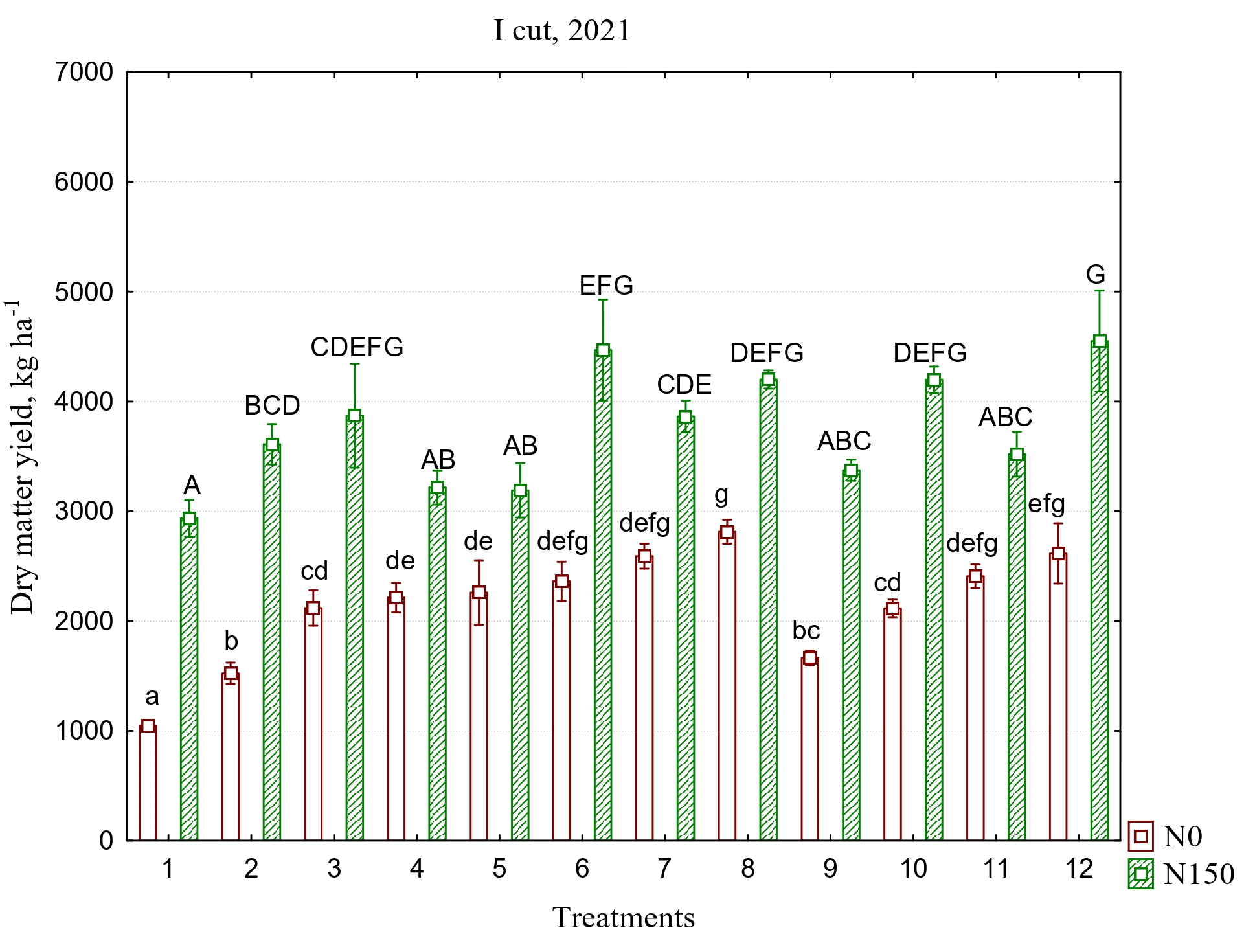
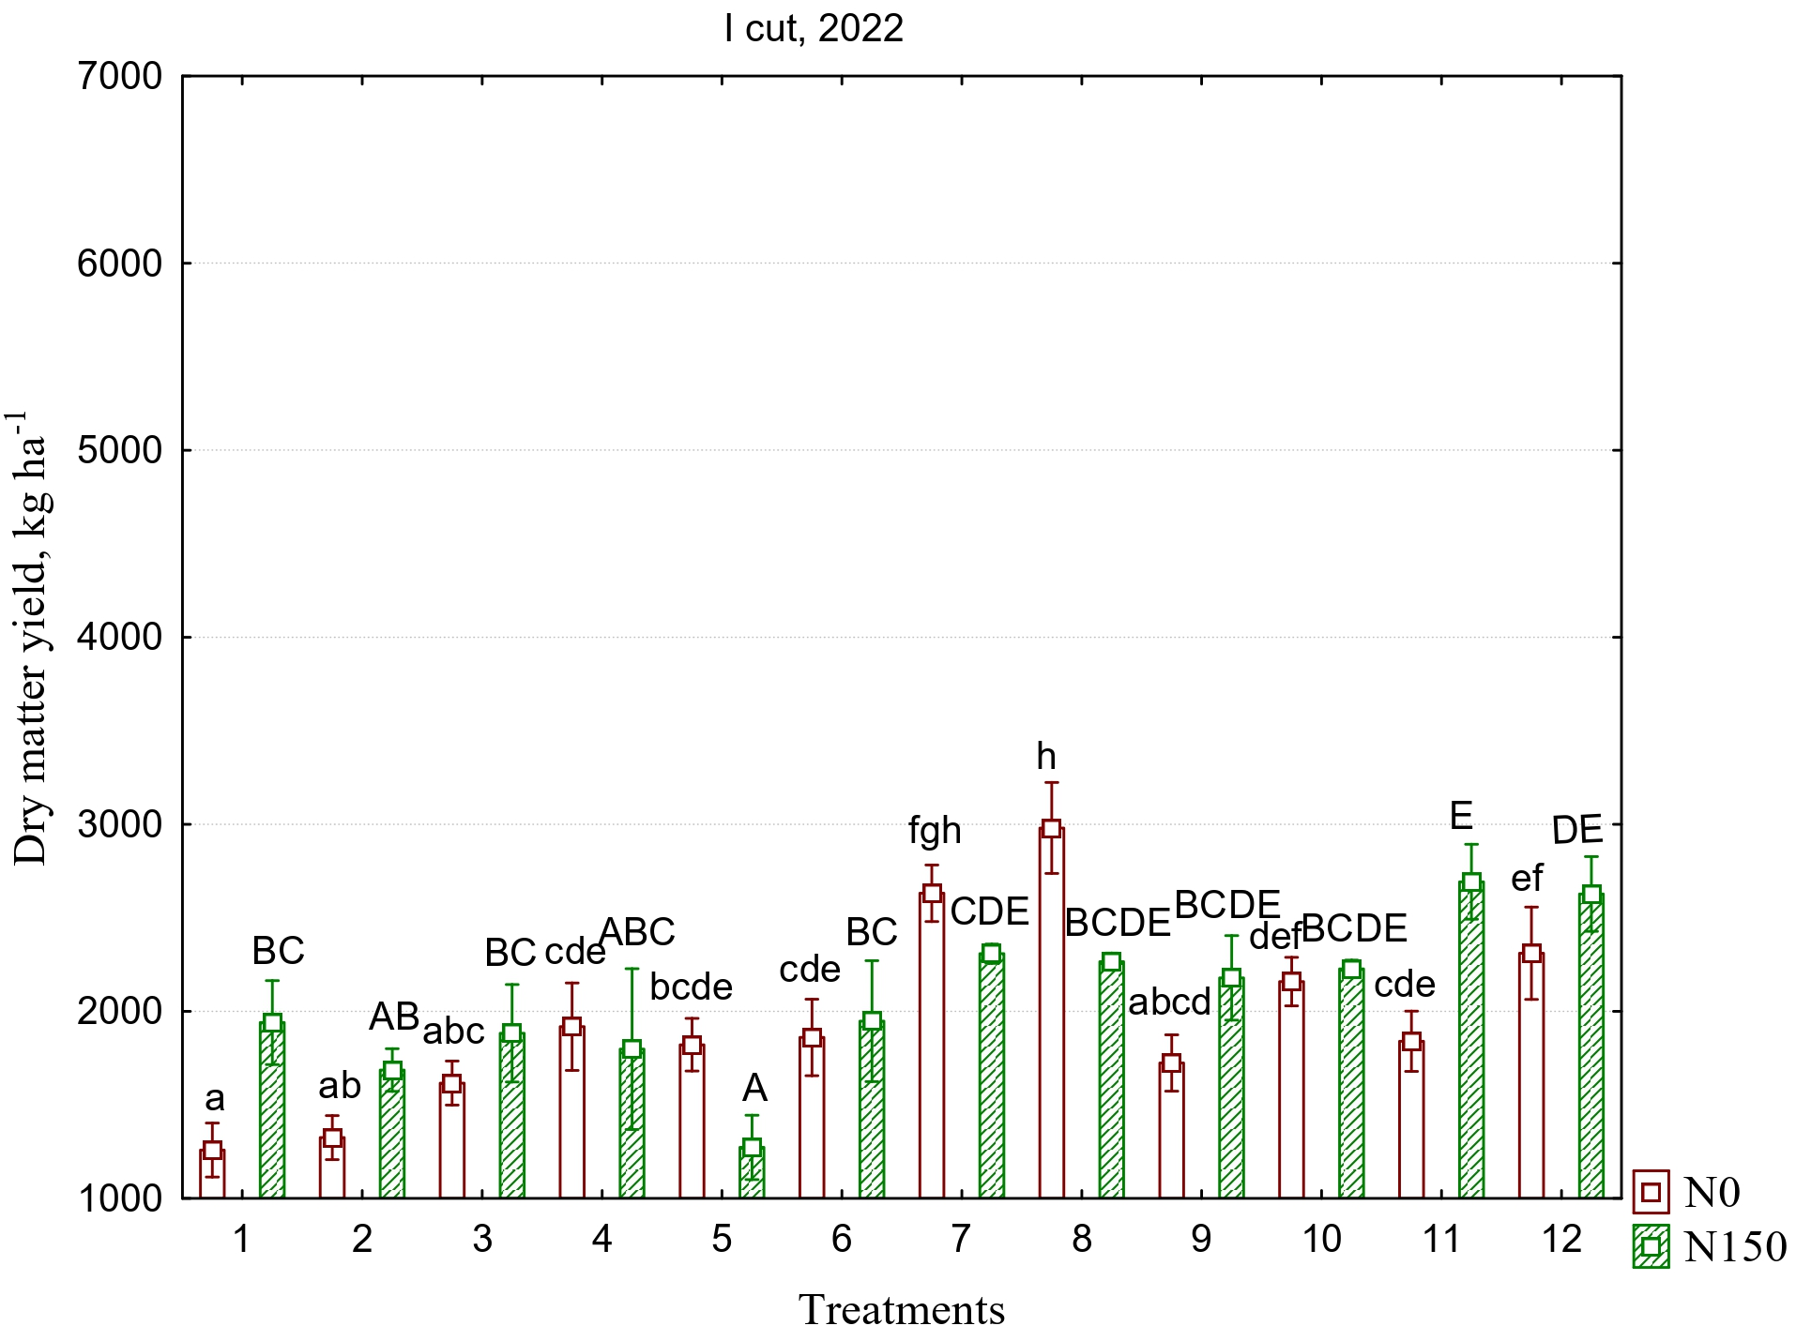
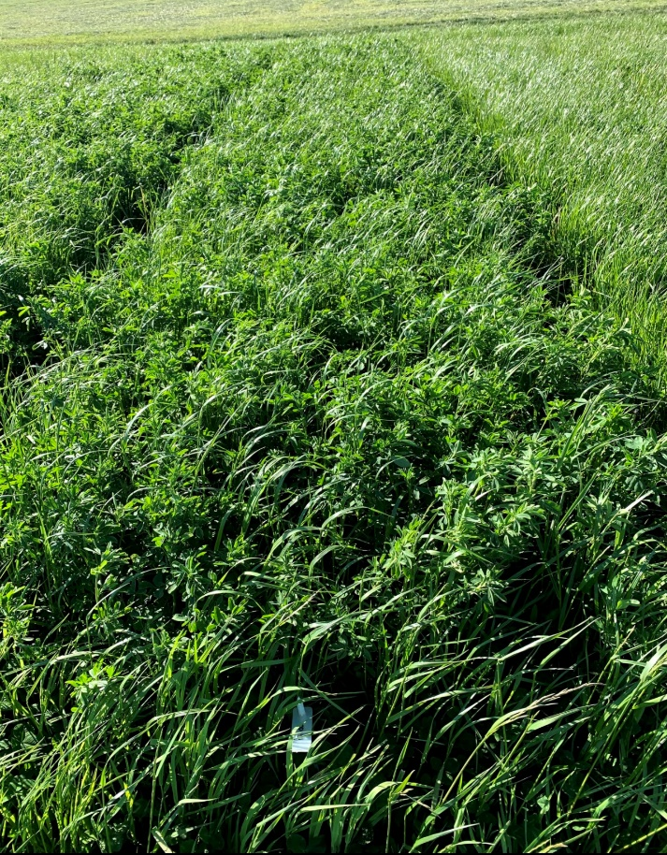
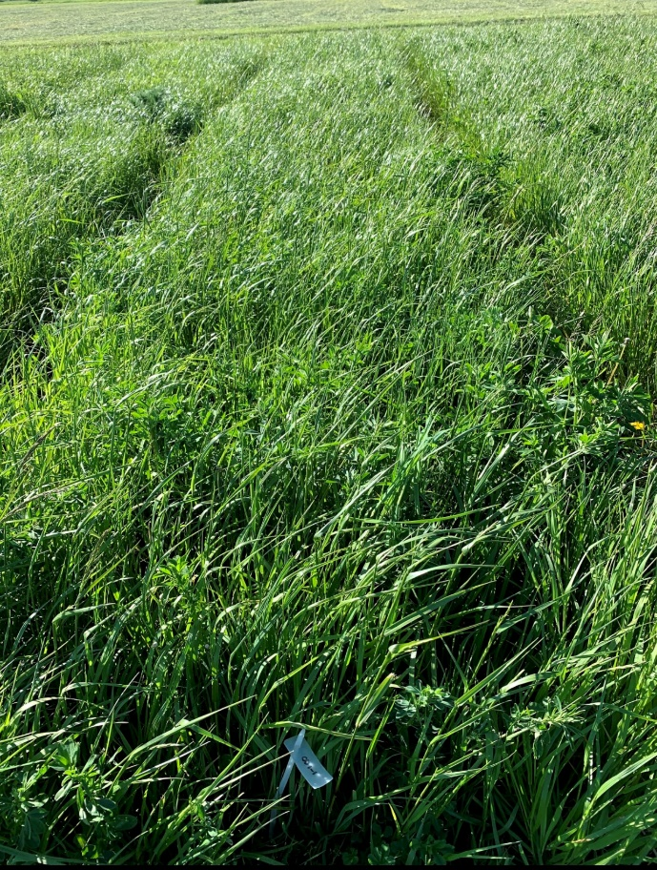
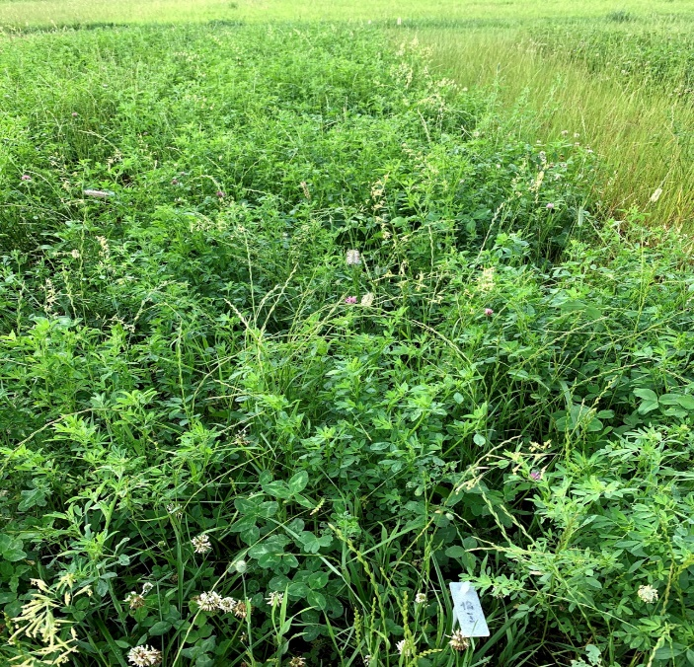
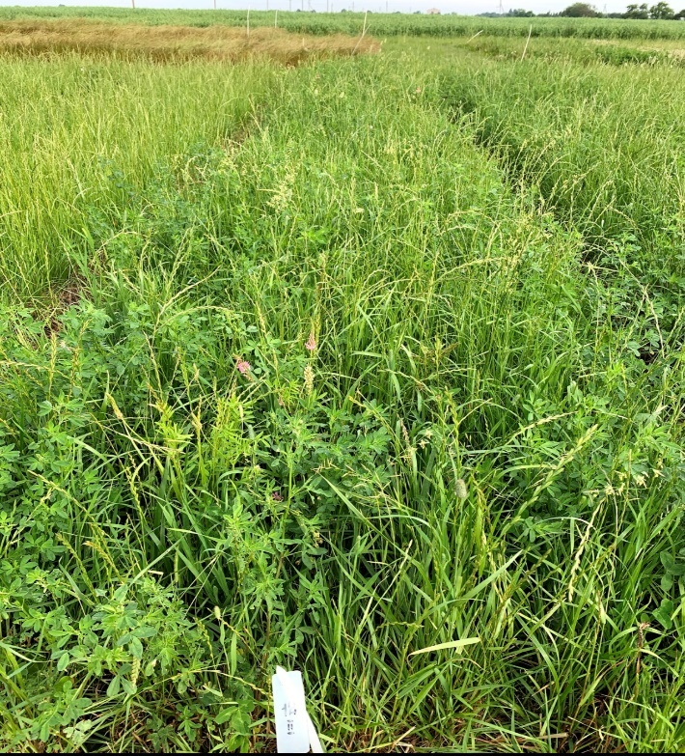
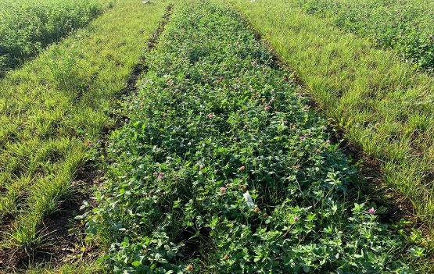
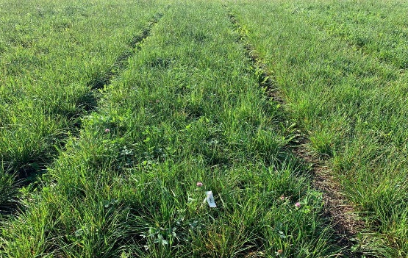

Changes in the herbage productivity for winter fodder during the 4-year of sward use
Šidlauskaitė G., Jaškūnė K., Kemešytė V., Šarūnaitė L., Kadžiulienė Ž.
Lithuanian Research Centre for Agriculture and Forestry
Instituto al. 1, Akademija, LT-58344 Kėdainiai distr., Lithuania
Introduction
Grasslands are a vital component of the food supply chain, providing feed for livestock, contributing to soil health, promoting biodiversity, and offering climate-related benefits. Plant specific diversity can influence swards characteristics and ecosystem processes. In this experiment were investigated the effect of N fertilization (N₀, N₁₅₀ kg ha ⁻¹) and different plant species composition on feedstock for winter forage.
Methodology
The main agrochemical characteristics of the top soil layer (0-25 cm) before this experiment was: neutral soil (pH 7.0), relatively high organic matter content (3.06 %) with high plant available P₂O₅ (220 mg kg⁻¹) and K₂O (173 mg kg⁻¹). The legume/grass ratio in the sown mixtures was 40:60. G1-Perennial ryegrass, G2-x Festulolium, G3-Meadow fescue, G4-Timothy; L1-White clover, L2-Red clover, L3-Lucerne, L4-Sainfoin.
Figure 1. Herbage yield in 2019-2022 years in the first cuts
Treatments: 1—G1, 2—G2, 3—L1 + L2/G1, 4—L1 + L2/G2, 5—L1 + L2/G1 + G2, 6—L1 + L2/G1 + G2 + G3 + G4, 7—L3 + L1/G1 + G2, 8—L3 + L1/G1 + G2 + G3 + G4, 9—L4 + L1/G1 + G2, 10—L4 + L1/ G1 + G2 + G3 + G4, 11—L1 + L2 + L3 + L4/G1 + G2, 12—L1 + L2 + L3 + L4/G1 + G2 + G3 + G4.
Different lowercase letters indicate significant differences between the treatments (N ₀) and uppercase letters (N₁₅₀); p < 0.05.
2020, before I cut (N ₀):
Treatment 8: G1 + G2 + G3 + G4/ L1+L3
Annual DMY: 9904 kg ha ⁻¹
CP: 15,8
2020, before I cut (N ₆₀):
Treatment 8: G1 + G2 + G3 + G4/ L1+L3
Annual DMY: 8931 kg ha ⁻¹
CP: 11,9
2020, before II cut (N ₀):
Treatment 12: G1 + G2 + G3 + G4/ L1+L3+L3+L4
Annual DMY: 9047 kg ha ⁻¹
2020, before II cut (N ₁₀₅):
Treatment 12: G1 + G2 + G3 + G4/ L1+L3+L3+L4
Annual DMY: 9270 kg ha ⁻¹
2020, before III cut (N ₀):
Treatment 3: G1/ L1+L2
Annual DMY: 8954 kg ha ⁻¹
CP:21,1
2020, before III cut (N ₁₅₀):
Treatment 3: G1/ L1+L2
Annual DMY: 9160 kg ha ⁻¹
CP:10,6
Results
A four-year experiment showed that N fertilizers application reduced the total biomass of legume grasses in the swards, thus reducing the quality and the overall swards productivity.
In the first three years of swards use, mineral nitrogen fertilizers significantly increased the biomass of the first cut but did not have a significant effect on the overall sward productivity.
The application of N fertilizers results in the I cut contributing, on average, 66.6% of the total swards biomass; in contrast, without the use of nitrogen fertilizers, the I cut accounts for 51.6% of the total biomass.
Conclusions
Mineral N fertilizers increase the yield of the I cut but do not significantly affect the overall annual productivity of the swards.
The species of legume grasses has a significantly influence on the overall productivity of the sward than the number of plants in the mixture.
The biomass of the I cut depends on the growing conditions and the age of the grasses.

