Slide 1
From Waste to Soil Amendments: LAMMC Agrobiology Laboratory’s Biocircular Approach to Sustainable Soil Health and Pollution Mitigation.
Presented by Modupe Doyeni
Agrobiology Laboratory
Lithuania Research Center for Agriculture and Forestry (LAMMC)
2025 October 27

Slide 2
About LAMMC – Institute Overview
(2024 Activity report)
Formerly known as the Academy of Agriculture, established in 1922
Lithuanian Research Centre for Agriculture and Forestry (LAMMC)- 2009
The strategic goal of the Centre is to conduct scientific research and experimental development in the fields of agricultural sciences:
3 main Research Institutes (the Lithuanian Institute of Agriculture, the Lithuanian Institute of Horticulture, and the Lithuanian Institute of Forestry).
>466 employees, including 184 researchers and 67 doctoral students.
Interdisciplinary focus: agronomy and forestry, and related areas of ecology and environmental science, biology, biophysics, botany, and zoology.
International collaborations (conducted 58 national and international projects).
Institute of Agriculture ( 8 departments - Agrobiology, Microbiology, Chemical Research, Genetics and Physiology, Herb Breeding, Cereal Breeding, Plant Nutrition and Agroecology, Plant Pathology and Protection, and Soil and Crop Production
Notes:
LAMMC is Lithuania’s leading agricultural research institution with extensive expertise spanning soil science, plant protection, agroecology, and forestry. We’re deeply engaged in applied research supporting both national and EU sustainability goals

Slide 3
The Agrobiology Laboratory – Core Expertise
Soil–microbe–plant interactions
Soil agrochemical properties and pollution studies
Application of plant nutrition diagnostics – assessment of macro- and micronutrient deficiencies and optimization of their amounts
Development and use of new mineral and organic fertilizers and liming materials
Quality, potential pollution, use of soil improvement materials
Environmental pollution prevention
Biomass processing
Biobased products
Soil application & amendments
Improved & sustainable crop yield
Waste generation
Notes:
The Agrobiology Laboratory serves as a hub for studying soil–microbe–plant relationships and developing circular biotechnologies from agricultural residues. Our interdisciplinary team links soil microbiology, biochemistry, and agronomy.
.Our framework is built on a simple but powerful idea: waste streams can be reimagined as soil amendments that improve fertility and mitigate pollution. This aligns perfectly with the EU’s bioeconomy and circular agriculture strategies

Slide 4
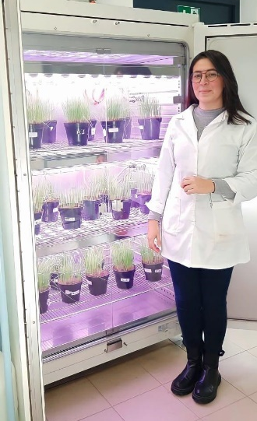
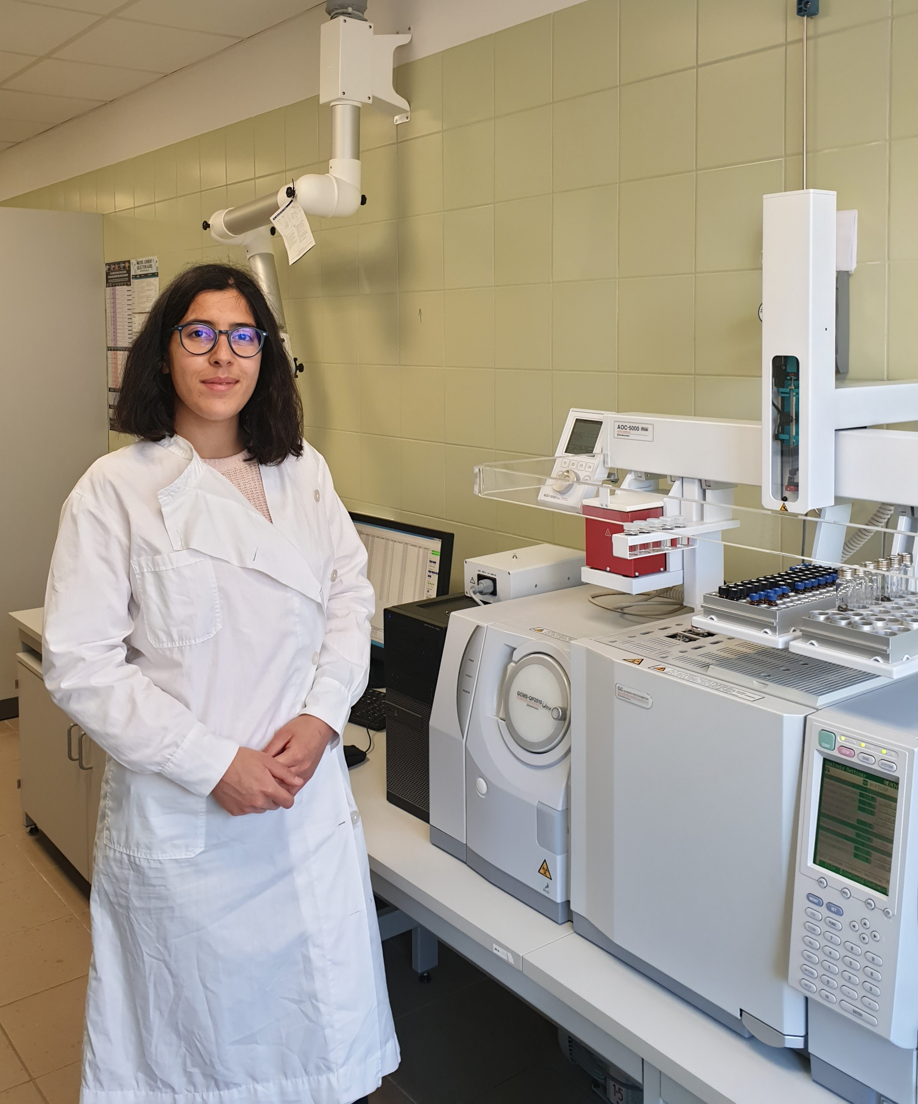
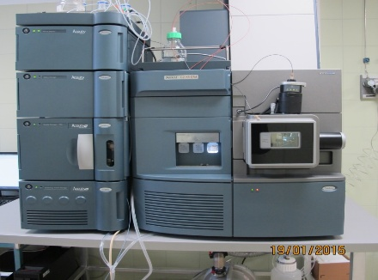
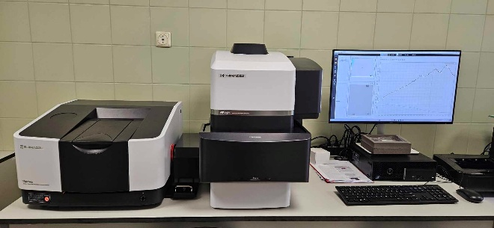
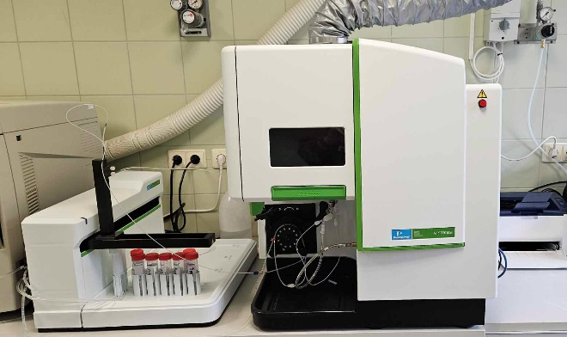
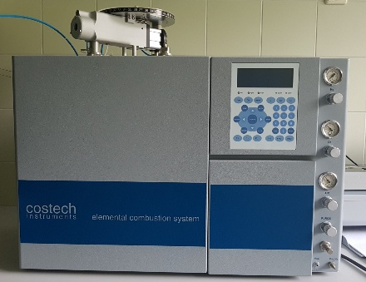
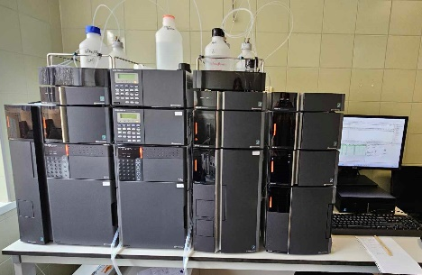
Instrumental analysis facilities
UPLC-MS, Xevo G2-XS QTof, Waters
FTIR-Raman spectrometer, Shimadzu
Pyr-GC-MS QP2010 Series, Shimadzu
Controled climate chamber CLIMACELL 707, MMM Medcenter Einrichtungen GmbH
CHNS-O elemental analyzer, Costech Instruments
Inductively coupled plasma with optical emission spectrometer detector, PerkinElmer
Ion chromatograph, Shimadzu
Notes:
Today, I am speaking on behalf of the entire Agrobiology Laboratory team. We are a multidisciplinary group of researchers specializing in agrobiological analysis, including soil science, the testing of innovative agricultural products, and the study of their interactions with soil and plants.
At the LAMMC Agrobiology Laboratory, we are equipped with a range of advanced instruments for analytical research, including controlled climate chambers. These are primarily used to assess the effects of various agricultural products on plant morphological and phytochemical characteristics, as well as on soil properties.
Recently, our infrastructure has been upgraded with an FTIR-Raman spectrometer and a pyrolyzer coupled with gas chromatography–mass spectrometry (GC-MS). We aim to employ these instruments for microplastic analysis in various matrices, with a particular focus on soil amendments and the residues remaining in soil following their incorporation. We also work extensively with ICP instruments for the analysis of macroelements and trace elements in soil. Additionally, ion chromatography is employed to determine plant-available ions.
Our work focuses on utilizing locally available waste materials, including bioash, biotextiles, and organic biowaste, to sustainably recover plant nutrients and develop innovative products. From external soil organic matters my and my group focus is on products prepared in different ways such as composting, anaerobic combustion and digestion produced from various waste streams. Unfortunately, we do not have the possibility to produce these soil amendments at our lab like digestate biochar or compost. For this reason, we are collaborating with industry or other scientific organizations. Main our interest is to evaluate these substances quality. For instance, nutrients levels, contaminants, ecotoxicity and effect on plants. These results give us insights about exogenous organic matters suitability to use for agricultural purpose. As well to promote circular agriculture, from waste to products. I am open to potential collaborations in future projects.

Slide 5
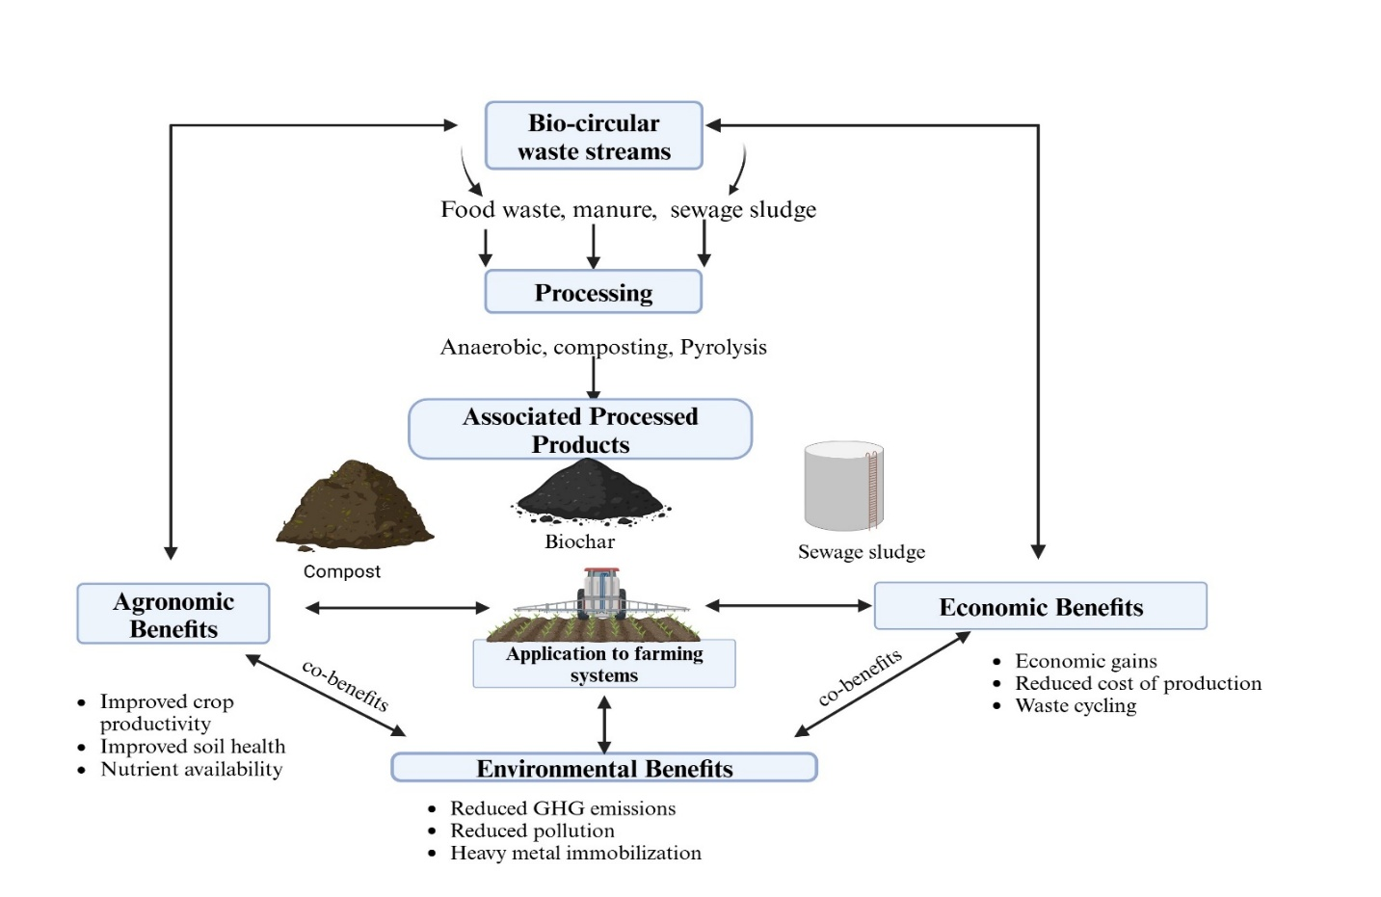
Introduction
Challenges of modern agriculture Soil degradation and nutrient depletion Microbial decline and biodiversity loss Accumulation of pollutants ( agrochemicals, heavy metals, microplastics) and GHG emissions Inefficient utilization of agricultural and agro‑industrial waste Dependence on non‑renewable inputs and energy‑intensive systems
Notes:
Across Europe, soil degradation and pollution continue to threaten long-term food security. The EU’s Soil Mission and Green Deal call for innovative, circular solutions that restore soil health while reducing environmental footprint. Research across LAMMC contributes to these goals through a bio-circular lens, turning waste into resources.

Slide 6
Relevance of research
Interconnection between waste recycling and agriculture
Sustainable Agriculture
Soil Health
Viable Economy
Food Security
Waste Utilization
Optimal Environment
Climate change
Livestock waste digestate

Slide 7
Study 1
Aim:
To evaluate the effect of animal manure digestates on the soil quality, microbial activity, greenhouse gas emissions, and productivity of agricultural crops.
Hypothesis:
It was hypothesized that the application of different types of animal waste digestate would reduce the emissions of GHG, improve soil microbial activity, and increase yield and quality of agricultural crops compared to synthetic nitrogen fertilizer in the soil.

Slide 8
Methodology
Field trials (3 years- Spring wheat, Triticale and Barley ) with 5 treatments
Laboratory experiments with two soil texture types
5 treatments
AGRICULTURAL FIELDS
COW MANURE DIGESTATE
CHICKEN MANURE DIGESTATE
PIG MANURE DIGESTATE
SYNTHETIC MINERAL FERTILIZER
CONTROL
Sandy loam soil
Loam soil
Split fertilized at an application rate of 90 and 80 kg N ha⁻¹
MICROBIAL ACTIVITIES
1. DEHYDROGENASE ASSAY
2. MOLECULAR ANALYSIS FOR PROKARYOTIC COMMUNITY
GHG MEASUREMENTS
CARBON DIOXIDE
NITROUS OXIDE
GRAIN YIELD & QUALITY
METHANE
SOIL CHEMICAL & PHYSICAL ANALYSIS
BIOMASS YIELD & CHEMICAL COMPOSITION
PRE & POST HARVEST ANALYSIS
SOIL MICROBIAL BIOMASS CARBON

Slide 9
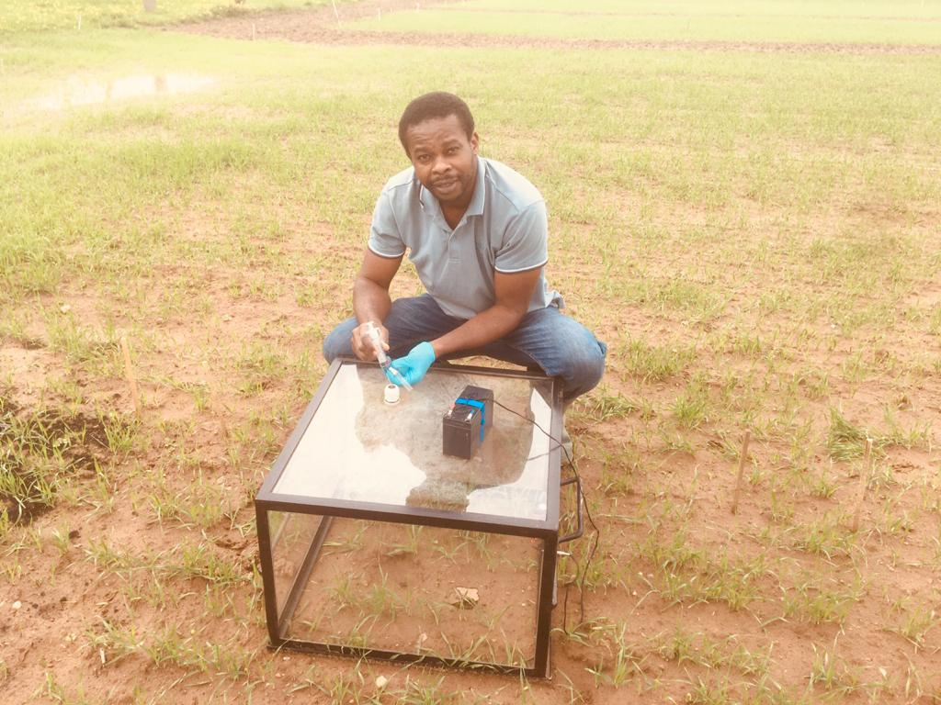
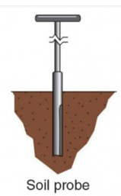
Key methods
For soil microbial analysis, fresh soil samples were homogenized, sieved (2 mm).
A total of 45 samples were taken per cultivation year across three sampling intervals—after each fertilization rate (tillering, stem elongation) and after harvest.
0.168 m²
20cm
The fluxes were measured by the static chamber-gas and measured using the gas chromatography technique.
For each flux measurement, the chamber was closed for 3 mins and the gas samples were taken in 20 ml by volume using a well-sealed 20 cc syringe.
Gas sampling at two-week interval
SMBC- chloroform fumigation extraction method (Vance et al., 1987).

Slide 10
Table 1. Main analytical characteristics of the animal manure digestate used in the experiment. The treatments were analyzed in triplicates (n = 3, mean ± SD). The treatments were collected and analyzed yearly (2018, 2019, 2020, and 2021). OM – organic matter; TN – total nitrogen; P2O5 - phosphorus pentoxide; K2O - potassium oxide; EC – electrical conductivity; PD – Pig manure digestate; CHD – Chicken manure digestate; COD – Cow manure digestate.
Fertilizers |  | PD |  |  | CHD |  |  |  | COD
Years Indicator | 2018 | 2019 | 2020 | 2021 | 2018 | 2019 | 2020 | 2021 | 2018 | 2019 | 2020 | 2021
pH | 8.20+0.17 | 9.00+0.36 | 8.6+0.21 | 7.51+0.12 | 7.60+0.33 | 9.80+0.4 | 8.80+0.26 | 8.6+0.12 | 8.10+0.21 | 8.30+0.33 | 8.4+0.36 | 8.11+0.06
OM (%) | 1.59+0.08 | 3.42+0.01 | 3.20+0.15 | 1.14+0.05 | 3.65+0.13 | 3.13+0.32 | 3.27+0.21 | 0.56+0.03 | 1.14+0.02 | 5.04+0.12 | 4.2+0.12 | 5.87+0.03
TN (%) | 0.16+0.05 | 0.51+0.03 | 0.33+0.02 | 0.26+0.02 | 0.62+0.02 | 0.51+0.02 | 0.59+0.06 | 0.36+0.02 | 0.26+0.01 | 0.34+0.01 | 0.32+0.02 | 0.43+0.02
P₂O₅ (%) | 0.15+0.01 | 0.12+0.02 | 0.13+0.02 | 0.05+0.0 | 0.21+0.04 | 0.15+0.06 | 0.18+0.02 | 0.04+0.01 | 0.14+0.02 | 0.11+0.01 | 0.16+0.04 | 0.05+0.02
K₂O (%) | 0.13+0.15 | 0.58+0.03 | 0.38+0.02 | 0.2+0.02 | 0.24+0.03 | 0.23+0.04 | 0.23+0.03 | 0.21+0.04 | 0.13+0.02 | 0.33+0.02 | 0.21+0.04 | 0.15+0.04
EC (mS m⁻¹) | 396+4.5 | 454+11.27 | 402+3.79 | 315+7.81 | 370+5.61 | 428+2.52 | 410+4.73 | 411+7.57 | 346+4.51 | 287+2.25 | 312+9.75 | 262+9.54
* The amount of the digestate applied was calculated according to its total nitrogen content and used to calculate the quantity of each digestate applied

Slide 11
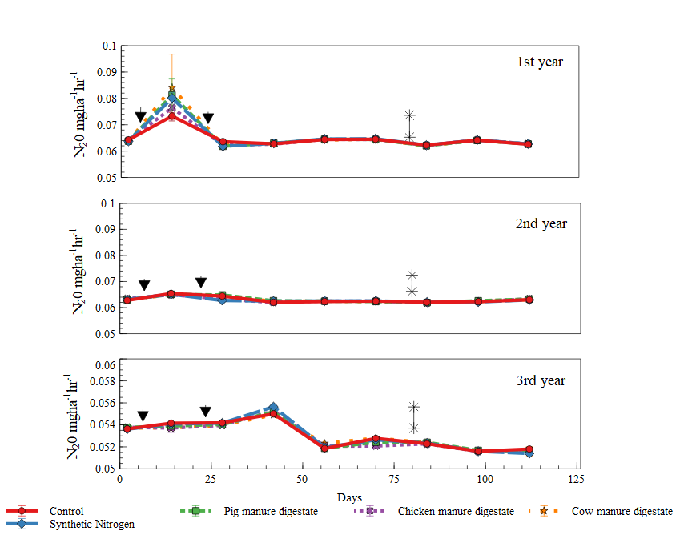
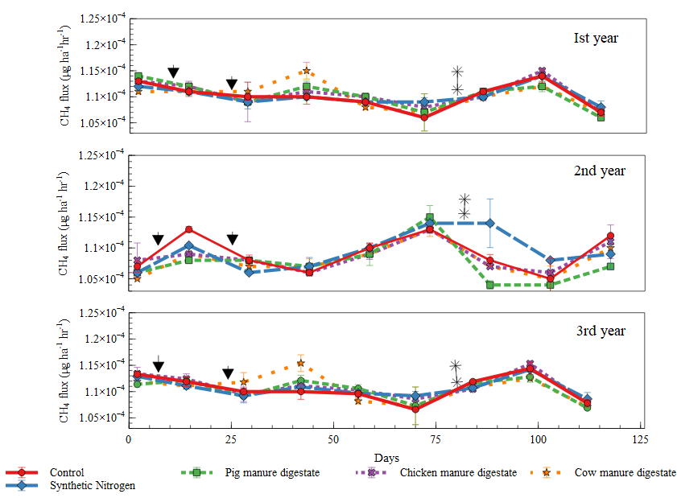
N₂O and CH₄ emission trend for 3 years
▼ Represent first and second digestate application at 90 and 80 kg N/ha; ** indicates after harvest; Days- measurement after sowing
Daily N₂O and CH₄ emission trend

Slide 12
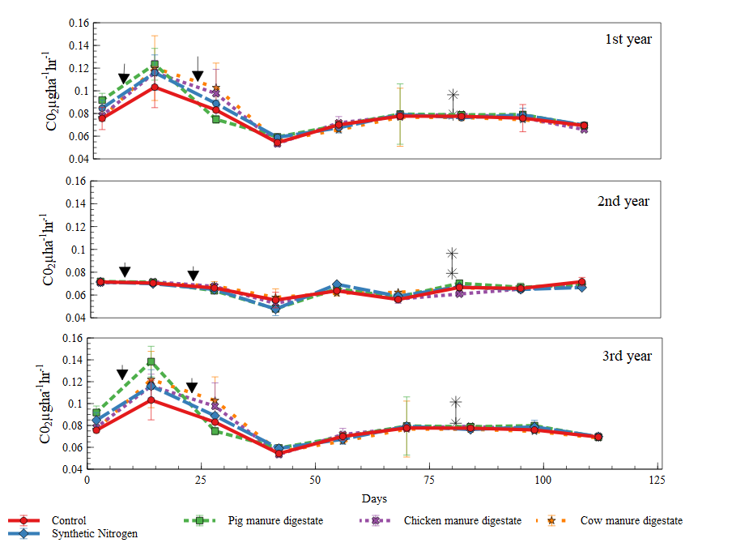
CO₂ emission trend for 3 years
▼ Represent first and second digestate application at 90 and 80 kg N/ha; ** indicates after harvest; Days- measurement after sowing
Daily CO₂ emission trend

Slide 13
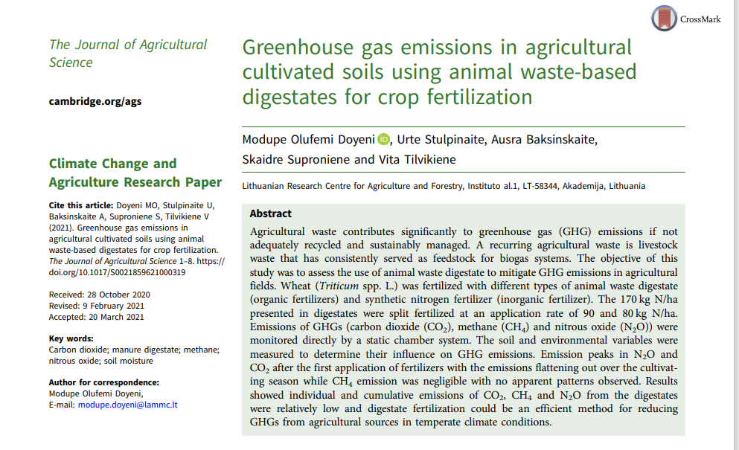
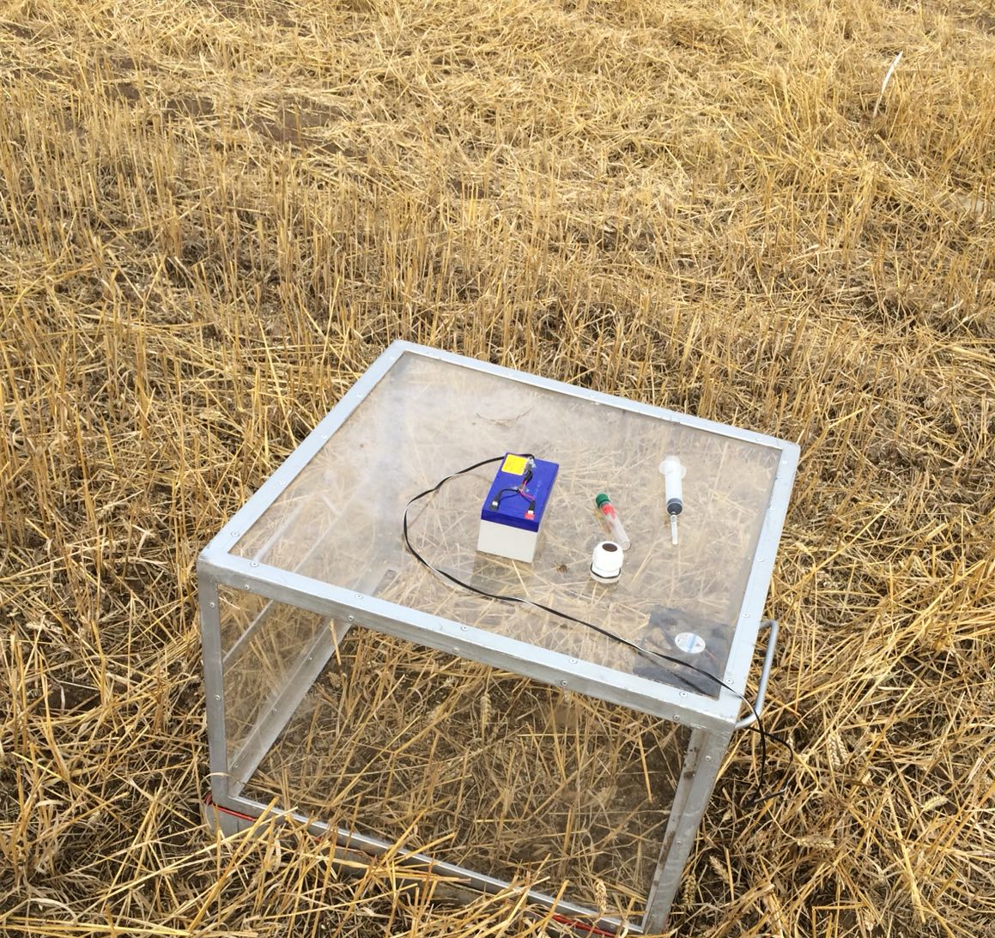
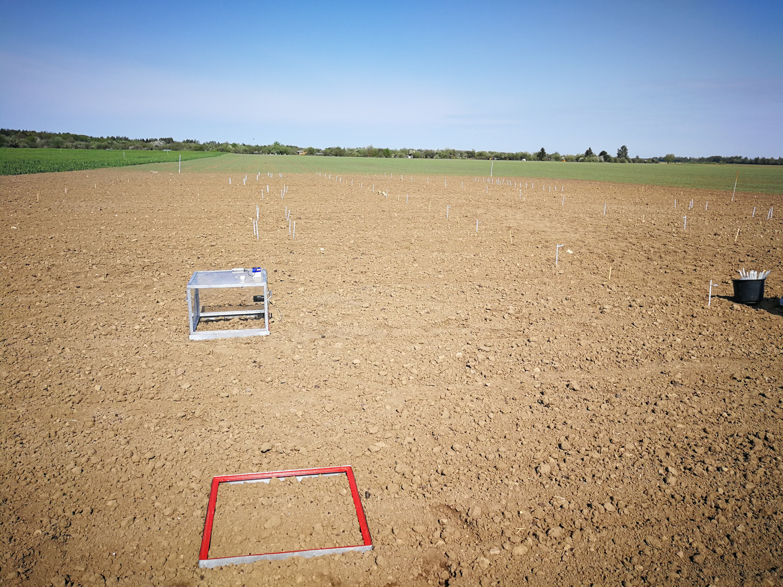
Key conclusions-1
Individual and cumulative N₂O and CH₄ emissions from soil applied with the animal manure digestate are relatively low and does not result in a greater emission of greenhouse gases than the use of synthetic nitrogen fertilizer under temperate climatic conditions.
Digestate fertilization demonstrated potential as a low-emission nutrient management strategy for temperate climates, with no negative environmental impacts observed and scope for longer-term evaluation.

Slide 14
Field trial (Result 2) - Soil prokaryotic relative abundance
Soil microbiota are labeled with respect to A) the treatment used or B) the sampling time. The fifteen major groups are reported at the phylum taxonomic level, except for Proteobacteria, which are reported at the class taxonomic level. Other phyla are collapsed within the group “other”.

Slide 15
Correlation between soil chemical features and selected taxonomic groups of microorganisms (genus)
Taxonomic group | Correlation
Genus | N | C | K₂O | P₂O₅ | pH | Humus
Puia | -0.234 | 0.893 | -0.681 | -0.591 | 0.952 | 0.895
Thermomonas | -0.174 | 0.832 | -0.644 | -0.639 | 0.957 | 0.836
Haliangium | 0.152 | -0.876 | 0.425 | 0.532 | 0.935 | -0.881
Massilia | -0.222 | 0.847 | -0.673 | -0.611 | 0.956 | 0.851
Arenimonas | -0.268 | 0.795 | -0.634 | -0.544 | 0.941 | 0.801
Arthrobacter | -0.274 | 0.813 | -0.715 | -0.576 | 0.967 | 0.818
Asticcacaulis | -0.274 | 0.813 | -0.715 | -0.576 | 0.967 | 0.818
Georgfuchsia | -0.397 | 0.893 | -0.510 | -0.342 | 0.947 | 0.898
Seinonella | -0.274 | 0.813 | -0.715 | -0.576 | 0.967 | 0.818
Aeromonas | -0.274 | 0.813 | -0.715 | -0.576 | 0.967 | 0.818
Fusobacterium | -0.274 | 0.813 | -0.715 | -0.576 | 0.967 | 0.818
Pelomonas | -0.274 | 0.813 | -0.715 | -0.576 | 0.967 | 0.818
Fonticella | -0.274 | 0.813 | -0.715 | -0.576 | 0.967 | 0.818
Nitrosomonas | -0.274 | 0.813 | -0.715 | -0.576 | 0.967 | 0.818
Anaerospora | -0.274 | 0.813 | -0.715 | -0.576 | 0.967 | 0.818

Slide 16
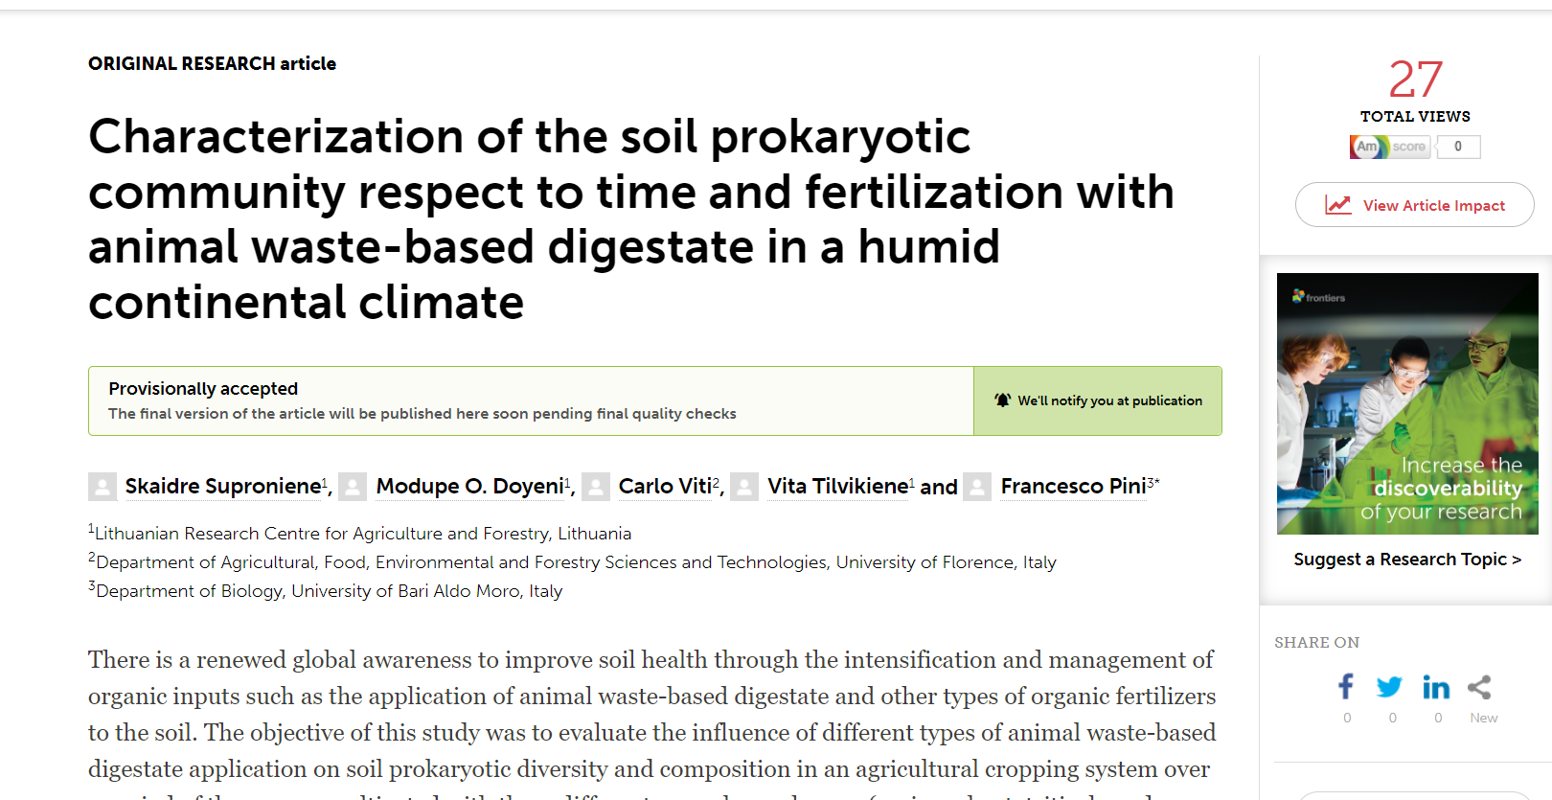
Key conclusions 2
Actinobacteria, Acidobacteria, and Proteobacteria were the dominant soil phyla (>55% of the total prokaryotic community).
Stable microbial diversity with animal manure digestate application not significantly altering soil prokaryotic diversity across the three years; community structure remained comparable to untreated soils.
Temporal and Environmental Influence with sampling time, environmental conditions, crop rotation, and tillage practices are the primary drivers of β-diversity shifts, not digestate type or treatment.
Soil pH correlated positively with several genera, influencing their relative abundance, whereas the observed pH decline over time was attributed to seasonal factors such as increased biological activity and nitrification rather than to digestate application

Slide 17
Field Trial (Result 3) Grain yield of crops
Grain yield of spring wheat, triticale, and barley, fertilized with synthetic mineral nitrogen fertilizer and different types of digestate. The columns with different letters show the significant differences between treatments for each crop at p < 0.05.

Slide 18
Field Trial (Result 4) Soil microbial biomass-Carbon
The effect of digestate fertilization on soil microbial activities – soil microbial biomass-Carbon
Treatments |  | First yr |  |  | Second yr |  |  | Third yr
 | First Fertilization | Second Fertilization | After harvest | First Fertilization | Second Fertilization | After harvest | First Fertilization | Second Fertilization | After harvest
Control | 144.94ab | 134.27ab | 130.56a | 114.85a | 128.39ab | 137.24a | 147.24a | 140.91a | 154.52a
Synthetic N | 119.29ab | 191.62b | 227.14d | 200.93b | 161.45b | 220.16d | 181.66a | 155.55ab | 192.01bcd
Pig Manure D | 133.61b | 164.16ab | 156.91ab | 238.02bcd | 134.23ab | 209.68bcd | 244.00d | 209.04d | 159.12a
Chicken Manure D | 100.17ab | 170.00ab | 204.17bcd | 273.52bcd | 117.89ab | 216.08cd | 188.41ab | 183.18bcd | 192.22d
Cow Manure D | 102.66ab | 184.89ab | 182.85abcd | 211.29d | 125.08ab | 187.41b | 236.20bcd | 181.98bcd | 163.79ab
Results of Anova analysis
Years 1 154.53b
A 2 179.02a
3 182.33a
Sampling Period
B First fertilization 174.44a
Second fertilization 158.85b
After harvest 182.6c
Treatments
C Control 133.66a
Synthetic N 183.77b
Pig manure D 183.10b
Chicken manure D 184.03b
Cow manure D 175.13c
The columns with different letters show the significant differences between treatment for each crop at p < 0.05.; F1- first fertilization rate at 90 kg ha ⁻¹ F2 – Second fertilization rate at 80 kg N ha ^{-1 ,} AH- After harvest p < 0,05.

Slide 19
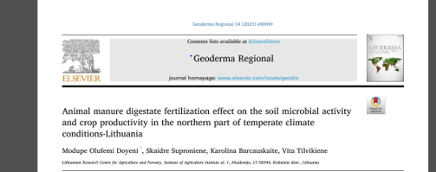
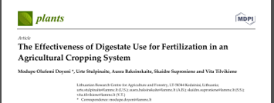
Key Conclusions 3 &4
Animal waste–based digestates significantly increased soil microbial biomass carbon (by 20.2–75.0%) and dehydrogenase activity compared to unfertilized and synthetic N-treated soils.
Digestate application improved crop yield by over 18% in the third year, outperforming synthetic nitrogen fertilizer, which showed yield gains only in the first year.
Cow manure digestate promoted the highest dehydrogenase activity due to its higher organic matter content and lower antibiotic residues.
Due to nutrient-specific properties, Chicken manure digestate enriched nitrogen and phosphorus availability in nutrient-limited soils, while pig manure digestate provided a balanced N–P–K nutrient profile supporting overall soil fertility.
Grain yield increased in the third year of digestate application, surpassing that of synthetic nitrogen fertilizer and indicating a cumulative beneficial effect under favorable climatic conditions.
Nitrogen use efficiency (NUE) in digestate treatments ranged between 20–25% and showed a strong positive correlation with grain yield, reflecting progressive improvement over time.
https://doi.org/10.1016/j.geodrs.2023.e00699
https://doi.org/10.3390/plants10081734

Slide 20
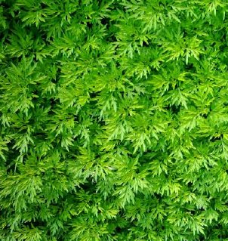
Study 2
Rethinking Biomass for Sustainable Agriculture
Global agriculture is shifting toward bio-based and low-input systems that align with the EU Green Deal and Circular Bioeconomy Strategy.
Non-food industrial crops like nettle (Urtica dioica), Artemisia (A. dubia),
and industrial hemp (Cannabis sativa) offer sustainable alternatives to conventional high-input crops
🔬 LAMMC Research Focus:
Exploring the multifunctional potential of nettle, Artemisia, and hemp biomass for soil health improvement.
Developing bio-based pest and disease control solutions from plant-derived bioactives.
Utilizing digestates and plant slurries as biofertilizers to stimulate soil microbiota and fertility.

Slide 21
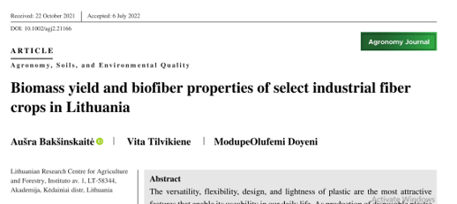
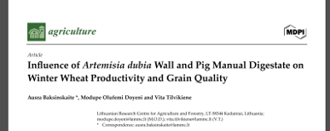
Study 2
Key Conclusions
In the Nordic–Baltic region, Miscanthus demonstrated the highest fiber extraction potential, yielding up to 38.0% high-quality fiber, with consistent biomass production, no annual replanting, and reduced labor costs—making it the most viable perennial fiber crop.
Miscanthus had the highest cellulose content (≈43%), mugwort exhibited a C/N ratio of ~96.2 favorable for decomposition and high lignin concentration, while Virginia mallow presented superior fiber length and width characteristics.

Slide 22
Research Interests
Soil microbiome responses to bio-based amendments
Waste valorization for agroecological inputs
Plant-derived biostimulants and biopesticides (nettle, Artemisia)
Soil pollution mitigation and nutrient recovery
Sustainable management of lignocellulosic biomass
Notes:
My research focuses on closing nutrient loops through plant-based biocircular strategies, combining soil microbiology, waste valorization, and crop resilience.”

Slide 23
Key Ongoing & Planned Projects
A.D.A.P.T. Project – Assesing the multifunctionality of Artemisia dubia
Biofertilizer
Biopesticide
Antimicrobial properties
Notes:
These projects lay the foundation for scaling our findings into EU-funded research networks. We’re particularly interested in joining Horizon consortia focused on soil restoration, organic waste utilization, and biobased innovation

Slide 24

Potential Collaboration Areas
Joint EU proposals (Horizon, COST, Interreg)
Collaboration and Knowledge Exchange
Mobility of early-career researchers & Doctoral/ graduate students
Notes:
We are very open to partnerships across institutions and disciplines. Whether through EU project consortia, researcher exchanges, or shared pilot trials, collaboration is central to our strategy.

Slide 25
Take home messages
LAMMC is a hub for agrobiological and circular bioeconomy research.
Our lab transforms waste into functional soil amendments.
There is strong alignment with EU Soil Mission and Green Deal prioritiesWe welcome collaboration for multi-institutional and EU-level projects

Slide 26
Thank you very much for your attention. I welcome your questions and ideas for potential collaborations.

