Slide 1

Innovations in the agri-food sector at Lithuanian Research Centre for Agriculture and Forestry (LAMMC)
DR. Aistė Balčiūnaitienė
Dr. Jonas Viskelis
Preparation of EIC Pathfinder Open Quality Application No. 10‑038‑T‑0055

Slide 2
LAMMC
The Lithuanian Research Centre for Agriculture and Forestry (LAMMC) is implementing the project “Preparation of a high‑quality EIC Pathfinder Open application” No. 10‑038‑T‑0055 (hereinafter – the Project) under the 2022‑2030 Development Programme Measure No. 12‑001‑01‑02‑01 “Strengthening Innovation Ecosystems in Research Centres,” activity “Support for identified start‑up R&D projects and feasibility studies, combined with institutional road‑mapping, to foster successful participation in Horizon Europe calls.”
Preparation of EIC Pathfinder Open Quality Application No. 10‑038‑T‑0055

Slide 3
LAMMC - What are we looking for „EIC Pathfinder“?
Complementary R&D partners.
• Universities or research institutes with strong track records in
‑ bio‑nanomaterials synthesis & characterization (advanced microscopy, spectroscopy)
‑ computational modelling of soft‑matter / condensed‑phase systems
‑ high‑risk, high‑gain frugal fabrication methods for TRL 1‑3 proof‑of‑principle.
Team composition must fulfil the Pathfinder rule of at least three independent legal entities from three different EU Member or Associated States and show clear interdisciplinarity.
Preparation of EIC Pathfinder Open Quality Application No. 10‑038‑T‑0055

Slide 4
LAMMC - What are we looking for EIC Pathfinder?
Scale‑up & technology‑integration partners.
• Engineering SMEs or RTOs that own pilot lines / pre‑industrial test beds (bio‑reactors 1–100 L, continuous coating, microfluidic encapsulation) able to lift key steps from gram to kilogram scale during the project’s lifetime.
• Access to GLP/GMP infrastructure is a plus for later Pathfinder Transition continuation.
Additional resources & services.
• High‑performance computing (for in‑silico design), advanced analytics (SEM‑EDS, synchrotron), and sustainable‑process Life‑Cycle‐Assessment support.
• Participation in the EC Partner Search tool and brokerage events to enlarge disciplinary breadth, as recommended by the Commission.
Preparation of EIC Pathfinder Open Quality Application No. 10‑038‑T‑0055

Slide 5
LAMMC - What are we looking for EIC Pathfinder?
Regulatory, IP & exploitation expertise.
• Consultancies or Tech‑Transfer Offices experienced with Horizon Europe exploitation packages, Freedom‑to‑Operate analyses and early market assessments, in line with the Pathfinder evaluation focus on credible routes to future uptake.
Application‑domain test beds.
• Agri‑tech, food‑tech or medical‐device companies willing to host in‑situ feasibility studies (bench‑top only – TRL ≤ 4), providing real‑world constraints and user feedback.
• Clinical or agricultural validation sites prepared to run small‑scale performance trials under ethical and biosafety supervision.
Preparation of EIC Pathfinder Open Quality Application No. 10‑038‑T‑0055

Slide 6
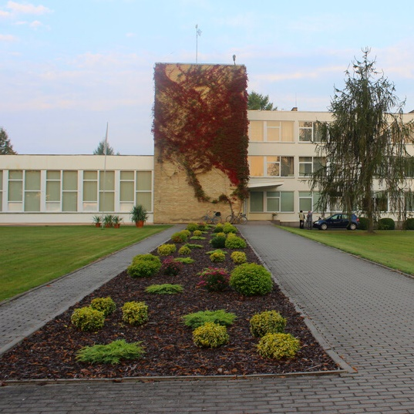
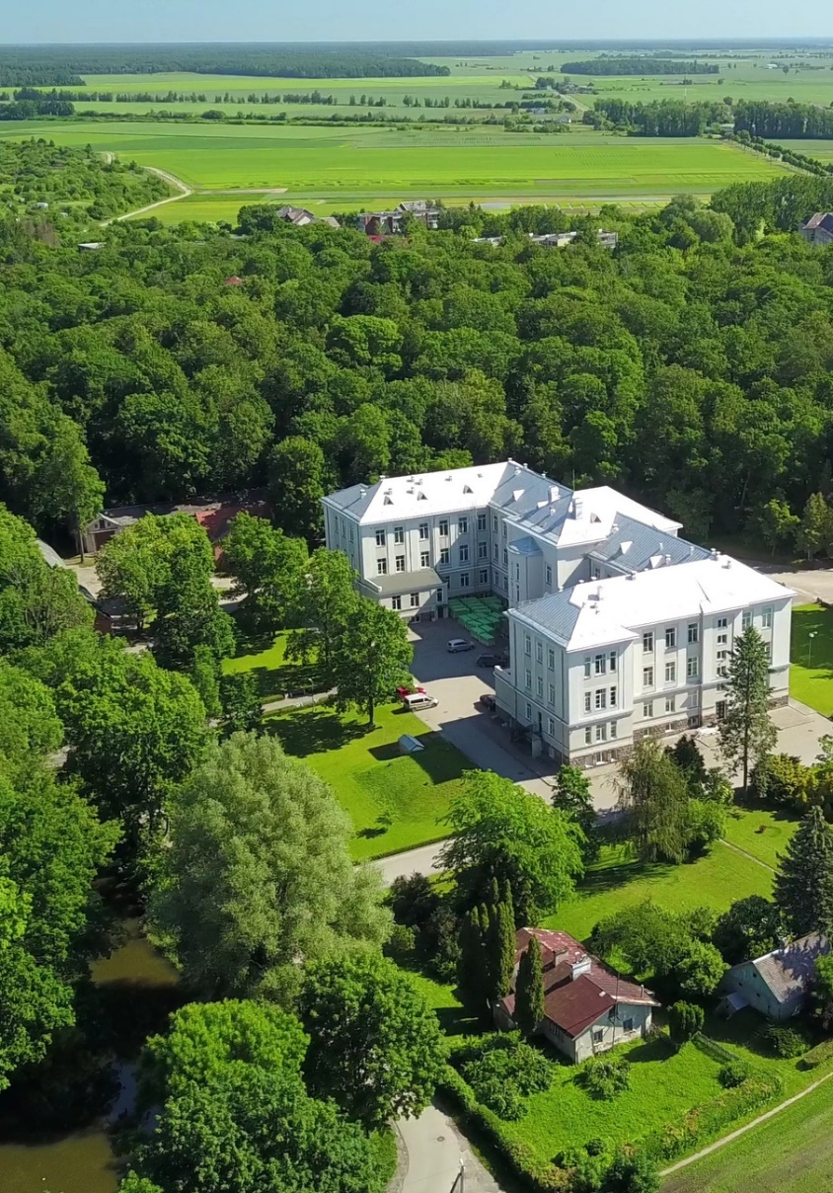
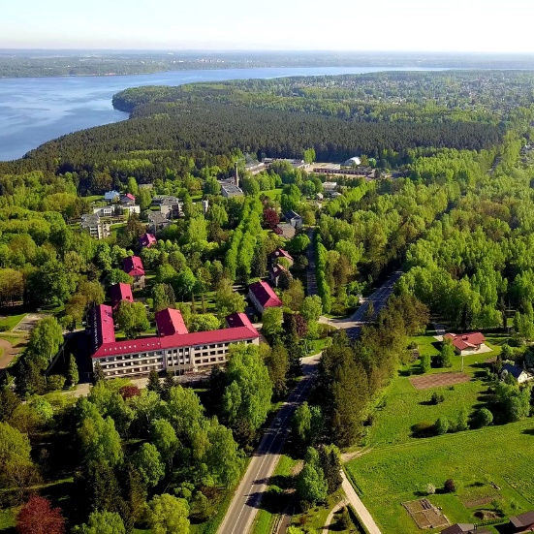
Key facts about LAMMC
178 researchers (total 473 employess)
67 PhD students
142 publications
13 plant cultivars
102 research projects
95 contracts with business
43 events
Preparation of EIC Pathfinder Open Quality Application No. 10‑038‑T‑0055

Slide 7

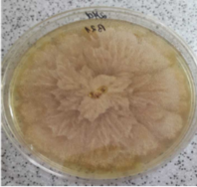
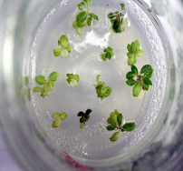
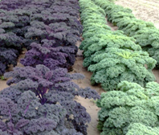
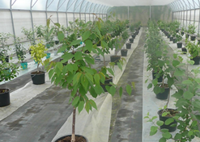
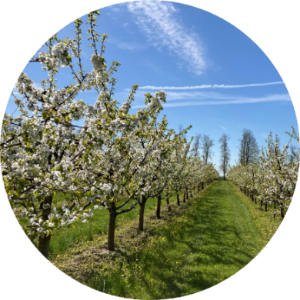
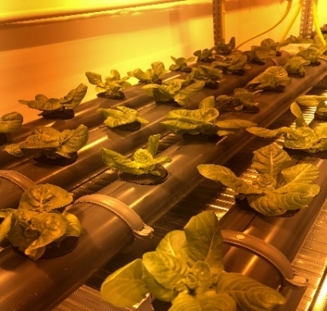
Research Directions of LAMMC
Preparation of EIC Pathfinder Open Quality Application No. 10‑038‑T‑0055

Slide 8
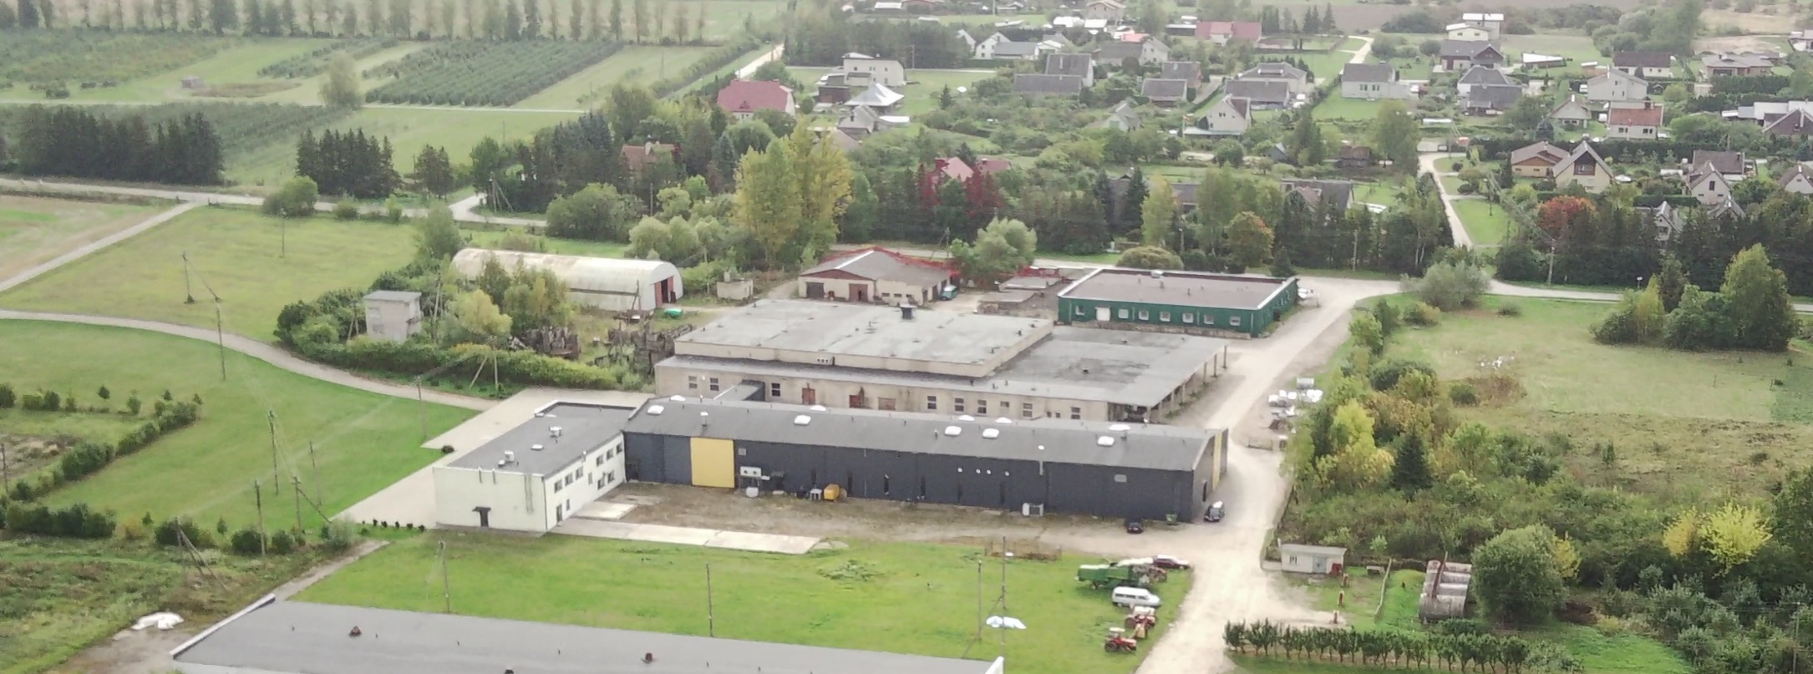
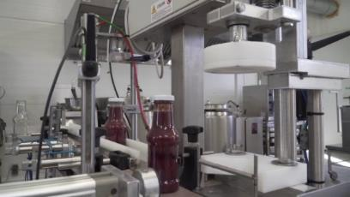
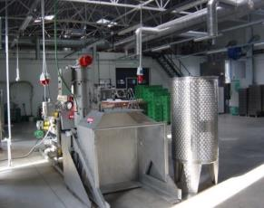
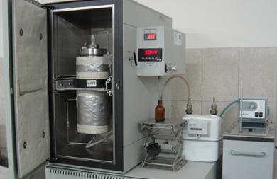
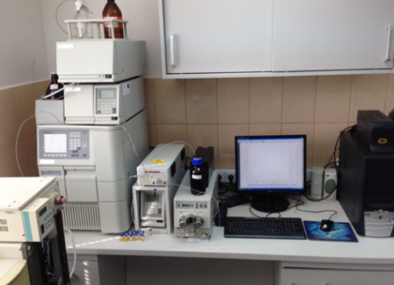
Open Access Centre for Modeling of Fruits and Vegetables Processing Technologies
Preparation of EIC Pathfinder Open Quality Application No. 10‑038‑T‑0055

Slide 9
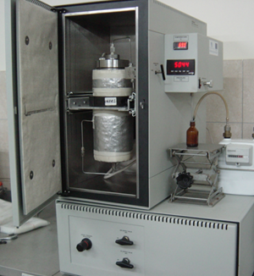
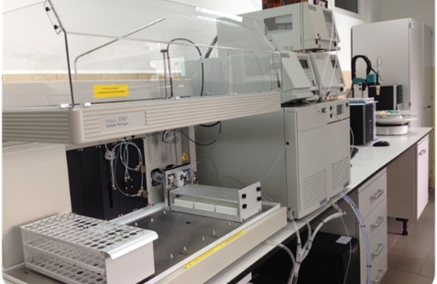
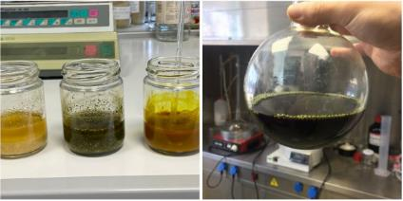
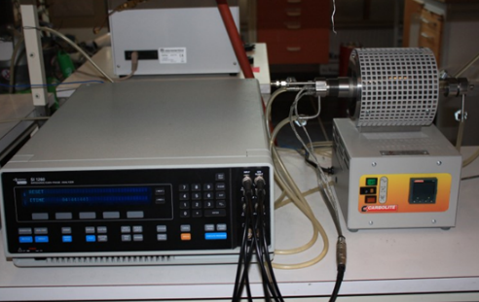
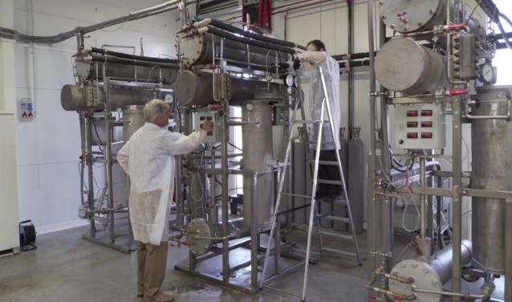
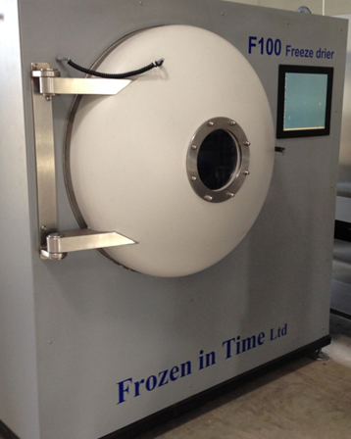
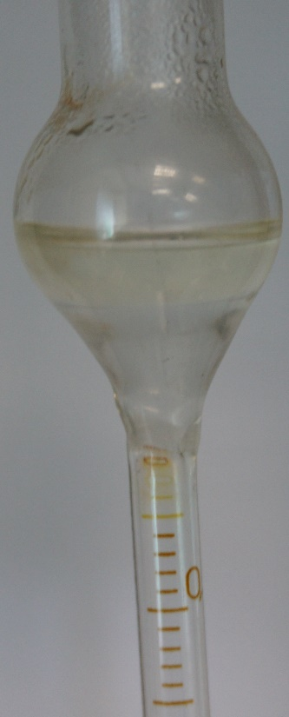
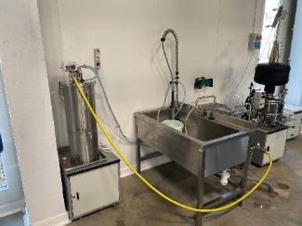
Preparation of EIC Pathfinder Open Quality Application No. 10‑038‑T‑0055

Slide 10
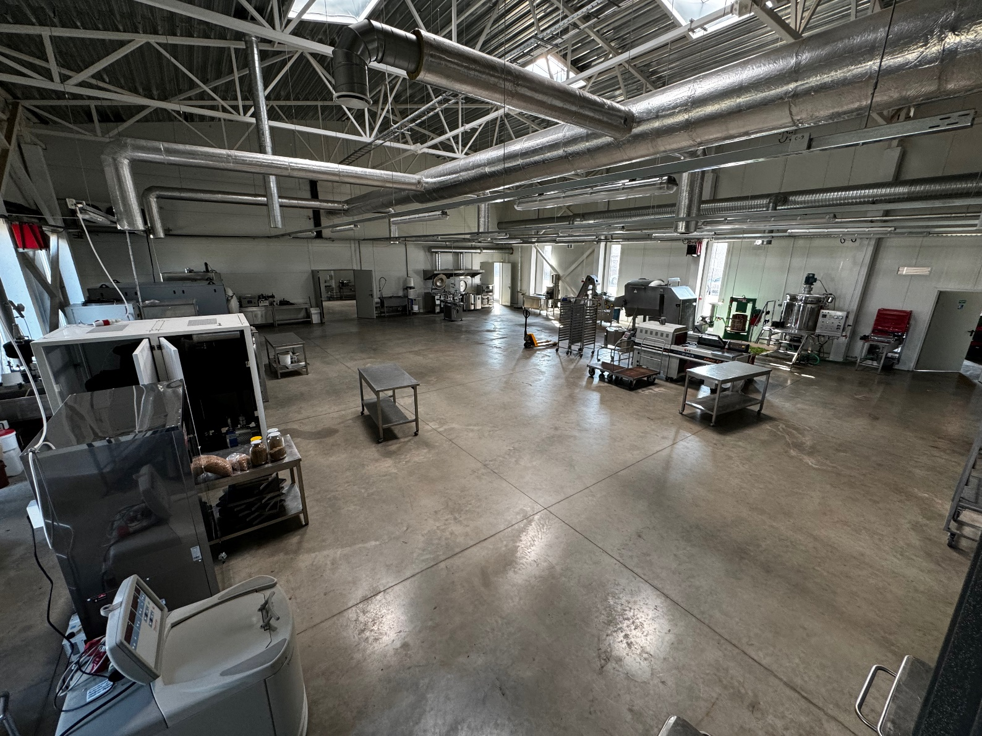
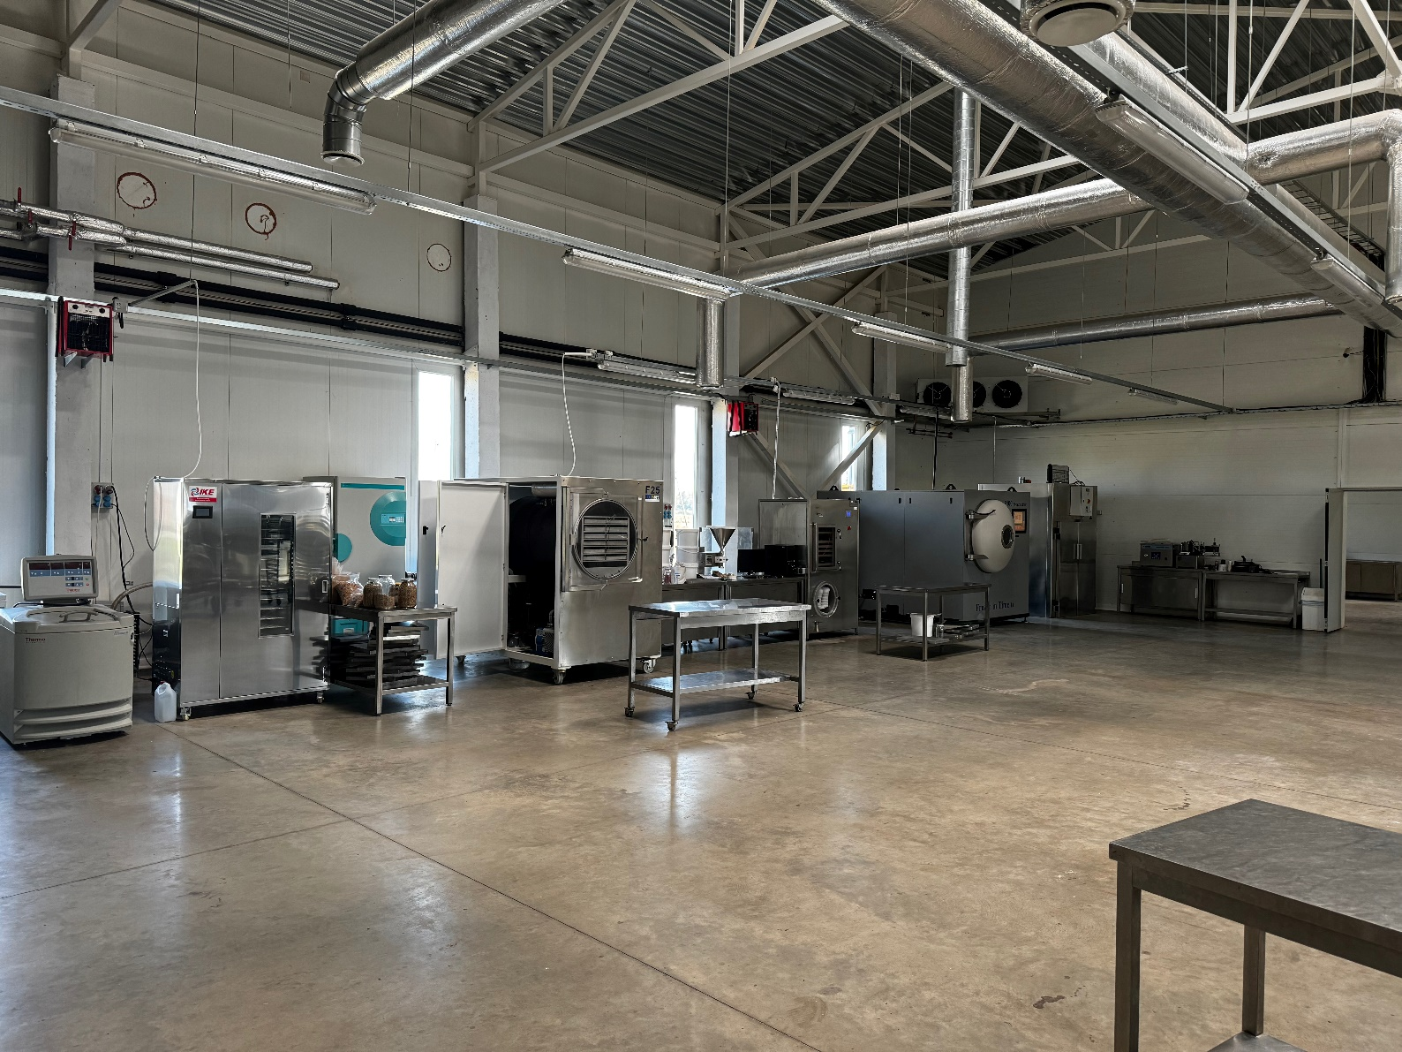
Preparation of EIC Pathfinder Open Quality Application No. 10‑038‑T‑0055

Slide 11
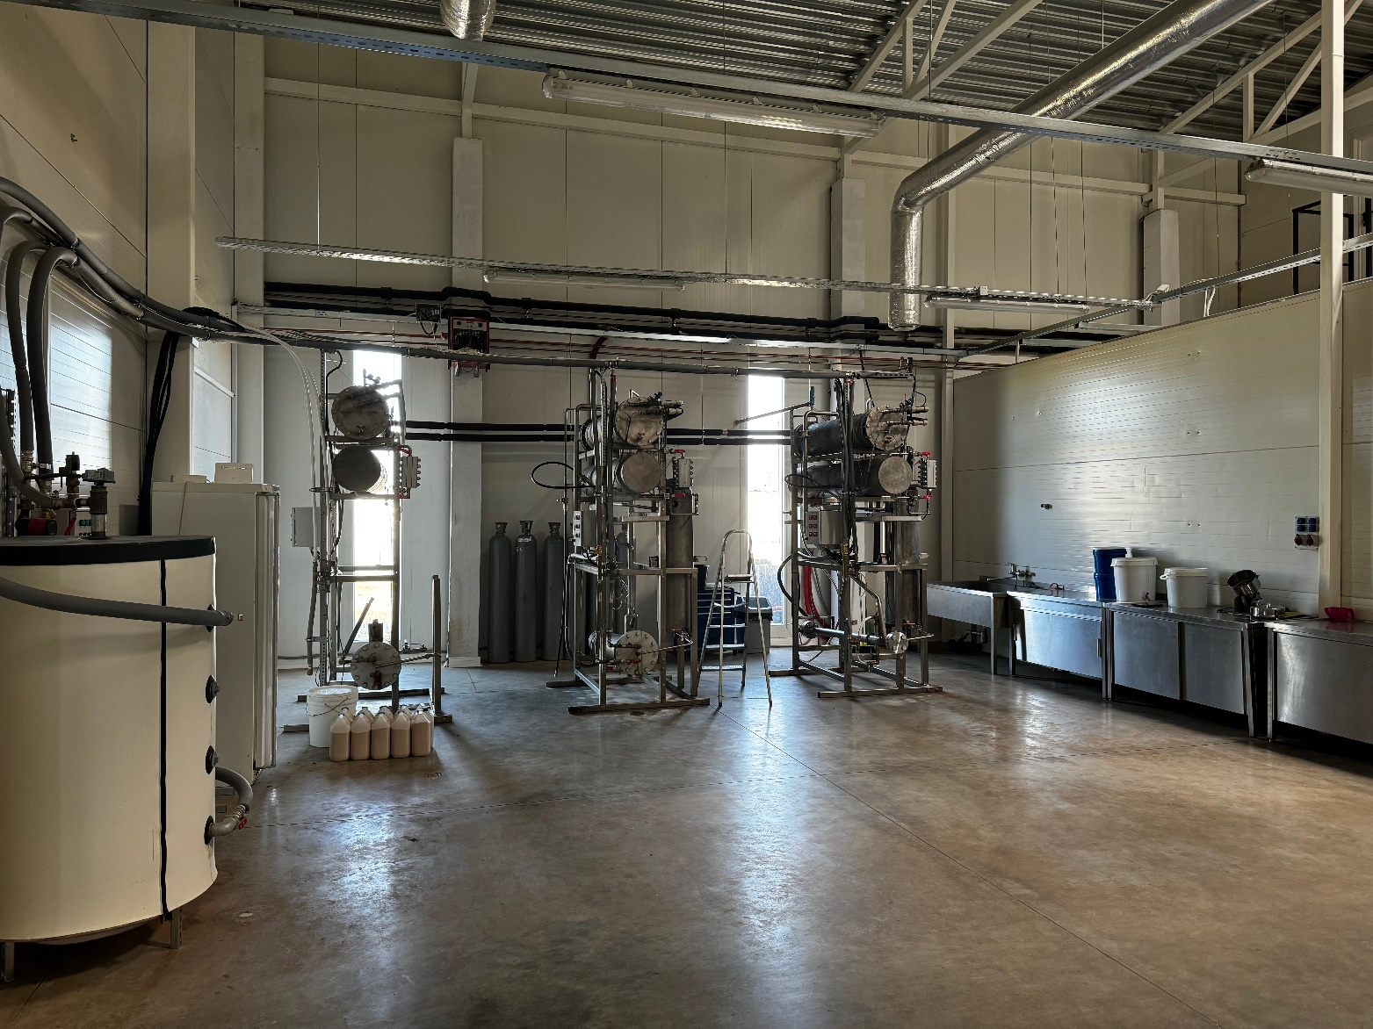
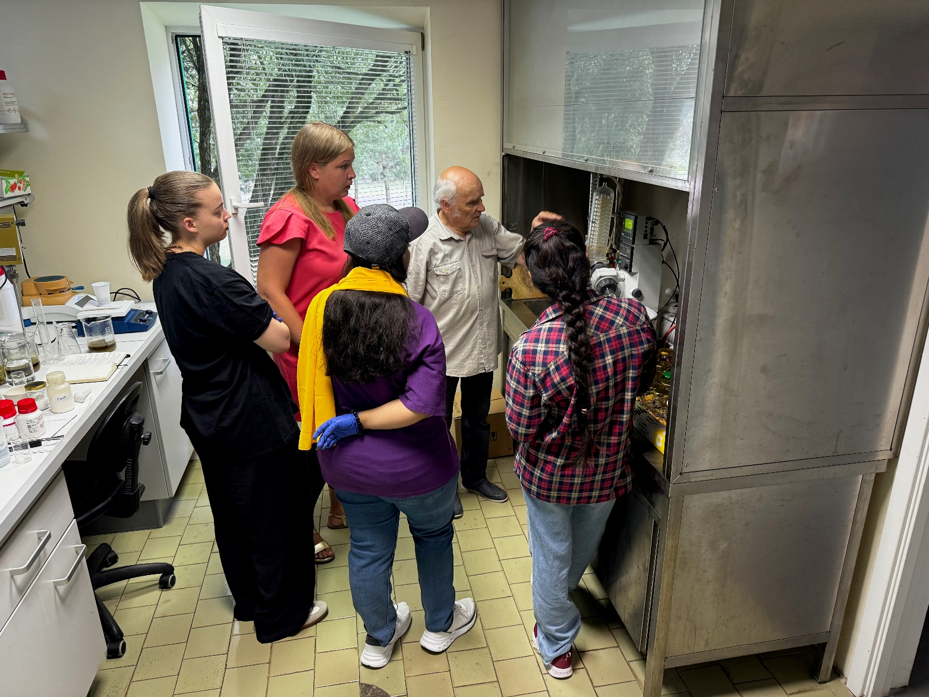
Preparation of EIC Pathfinder Open Quality Application No. 10‑038‑T‑0055

Slide 12









Processing chain
Raw materials
Primary processing
Secondary processing
Tertiary processing
Food
(berries, fruits, vegetables, ...)
Food products (juice, jam, ...)
+
Secondary processing byproducts
Bioactive compounds (pigments, oils, aromatic compounds, ...)
Fillers for plastics, etc.
Food industry
Food & Agro industries
Food, pharmacy, sports industries
Polymer industries
Preparation of EIC Pathfinder Open Quality Application No. 10‑038‑T‑0055

Slide 13

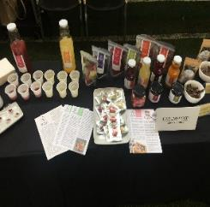


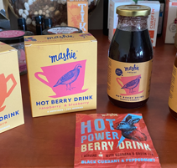
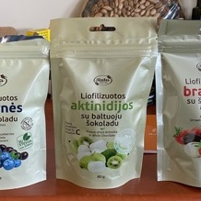
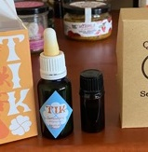
Creation of Functional Food Prototypes
Creation of Individual Recipes
Nutritional Analysis & Optimization
Sensory Evaluation & Consumer Testing
Stability & Shelf-Life Testing
Regulatory & Labeling Compliance
Production Scalability & Process Standardization
Functional Ingredient Research
Preparation of EIC Pathfinder Open Quality Application No. 10‑038‑T‑0055

Slide 14
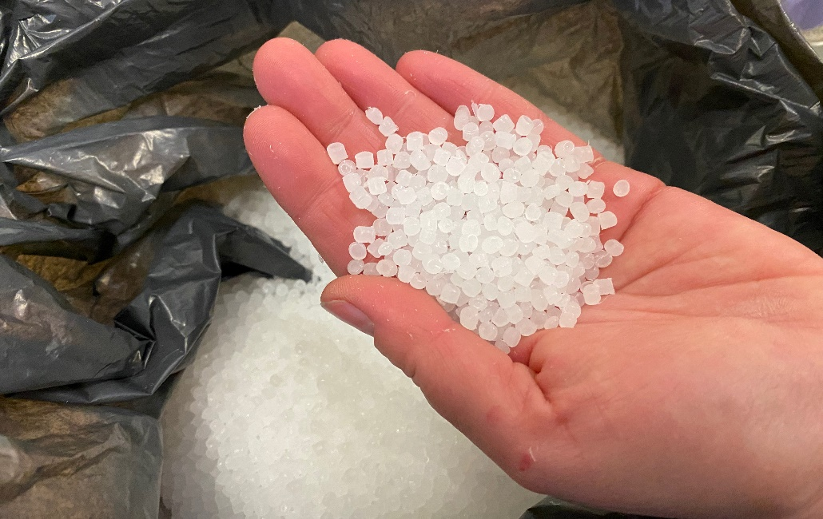
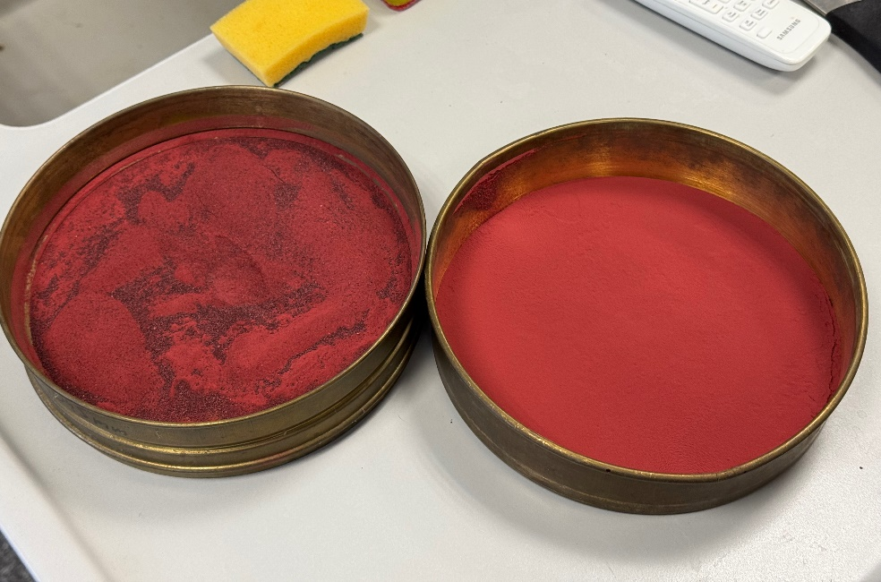
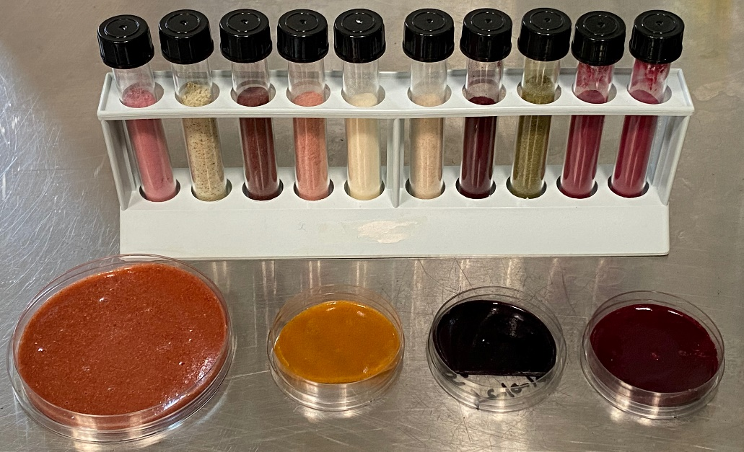
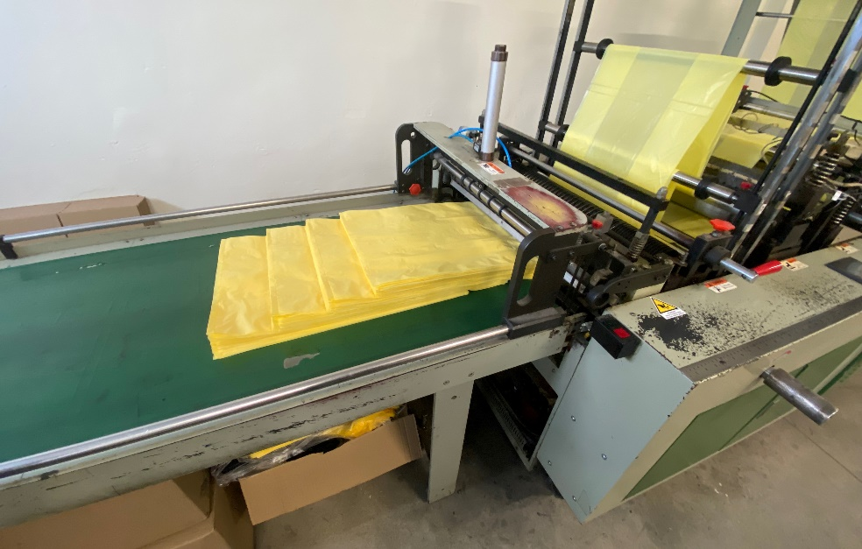
Development of natural, biodegradable pigments for industrial polymers
Project funded by Research Council of Lithuania, (LMTLT) agreement No. S-MIP-23-141
Preparation of EIC Pathfinder Open Quality Application No. 10‑038‑T‑0055

Slide 15
Thank You!
Preparation of EIC Pathfinder Open Quality Application No. 10‑038‑T‑0055

