Slide 1




Cryogenic freezing of apple, carrot, and tobacco suspension cultures and their cryopreservation peculiarities
J. Vinskienė, Baniulis D., Tamošiūnė I., Rugienius R.
Institute of Horticulture, Lithuanian Research Centre for Agriculture and Forestry, Lithuania
E-mail: rytis.rugienius@lammc.lt
Objectives
In vitro plant cell suspension culture is considered as an effective alternative to traditional recombinant protein production methods, the induction of somatic embryogenesis, and other biotechnological purposes. The performance and transferability of CP protocols for plant cell cultures is currently limited by the diverse properties of plant cells from different species or even different tissues of the same species. Therefore, unique protocols may therefore be required in order to achieve effective preservation of plant cells.
The goal of our study was to determine the most suitable cryopreservation (CP) conditions for long-term storage of apple, carrot, and tobacco (GM / non-GM) cell suspensions in liquid nitrogen using different cryoprotectors and their mixtures (sucrose, glycerol, vitrification solution, sorbitol, and DMSO), dehydration and freezing time regime ensuring the viability of cells after CF treatment.
5 – 9 MAY 2025, ITALY

Slide 2
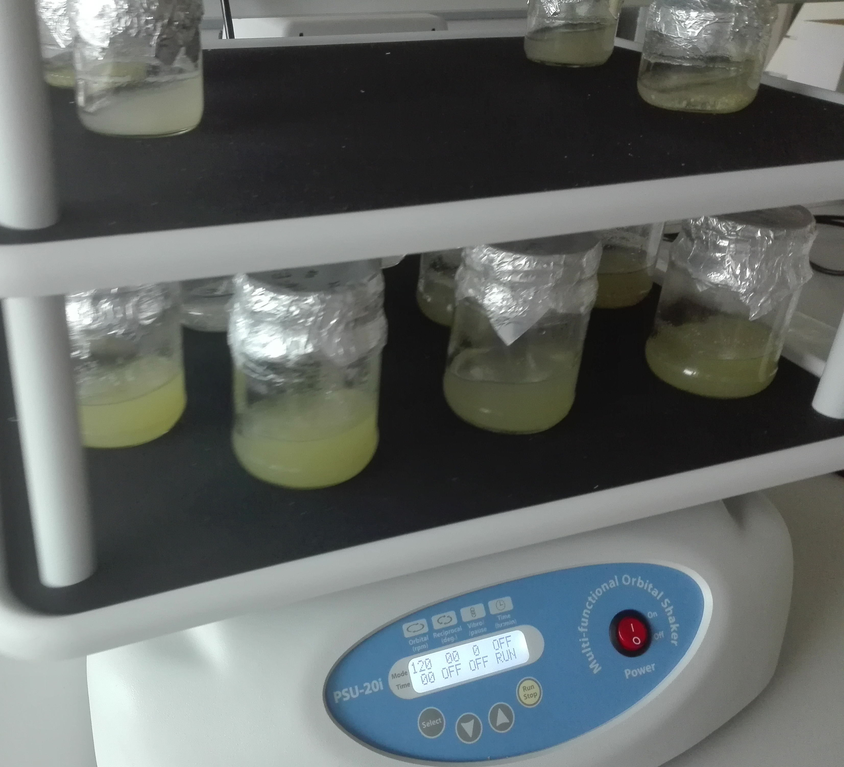
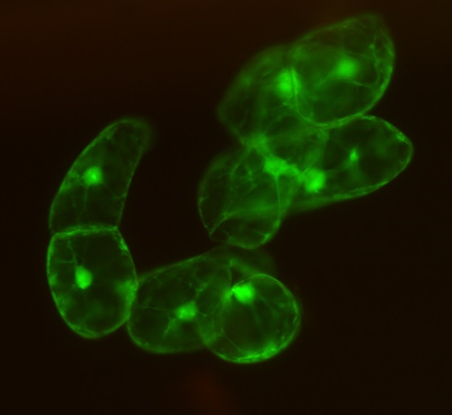
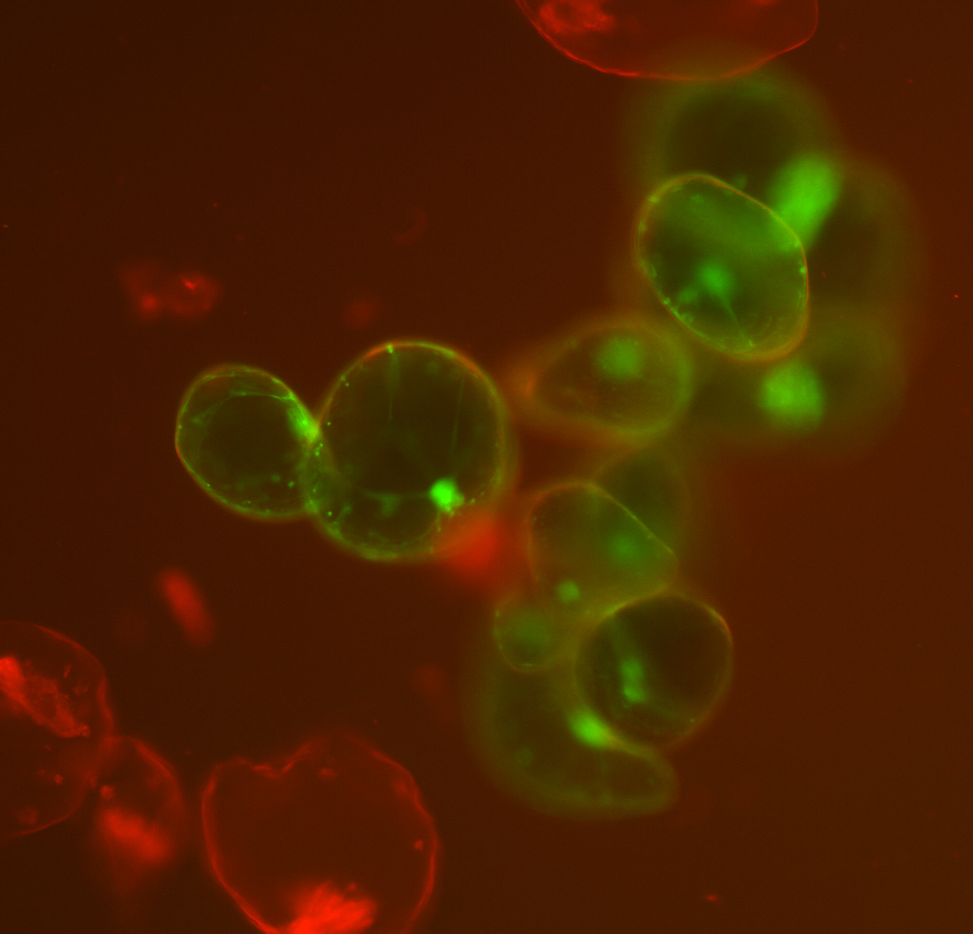
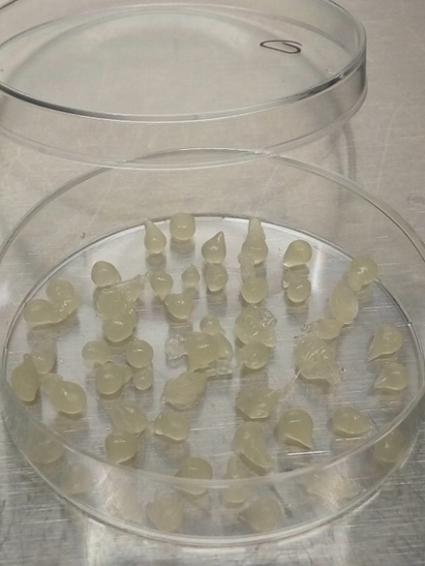
B
Material and Methods
Cell suspension culture (CSC) establishment. Apple (Malus x domestica Borkh.) cv. Gala, GM / non-GM tobacco (Nicotiana tabacum L.) cv. Samsun-NN and carrot (Daucus carota L.) cv. Ieva dedifferentiated cells (callus) generated from leaf and root explants at the Laboratory of Cryobiology of the Institute of Horticulture (LRCAF, Lithuania).
Growth. Basal MS (Murashige and Skoog, 1962) medium enriched with sucrose (3%) and a combination of 2,4-D (0.3 mg L⁻¹) and casein hydrolysate (1 mg L⁻¹) for carrot CSC; 2,4-D (1.0 mg L⁻¹) for apple and a combination of BAP (0.25 mg L⁻¹) and NAA (2.0 mg L⁻¹) for tobacco CSC growth.
Maintenance. In vitro plant cultivation chamber at 22±3°C, 50 μmol m⁻² s⁻¹ illumination intensity, a 16-hour photoperiod and slow shaking at 120 rpm. Transfer CS cells to a fresh medium every 7-14 days.
Cell culture cryopreservation (CP). Encapsulation-vitrification methods according to Kobayashi et al. (2005; 2006), Menges and Murray (2004) for tobacco and carrot cell cultures CP. Encapsulation-dehydration / vitrification methods for apple and carrot cell cultures CP.
Viability assessment. 0.25% Evans blue dye or fluorescein diacetate (FDA) staining. Viable cells (%) were calculated by dividing the stained cells by the total cell count.
B
A
Figure 1. (A) Tobacco CS cells’ maintenance;
(B) Apple CS cells encapsulated in sodium alginate (SA). Scale bar 1 cm.
A
B
B
Figure 2. Viable (A) apple and (B) tobacco CS cells in 0.02% FDA dye solution. Nikon Eclipse 80i (Nikon, Tokyo, Japan) fluorescent microscope. Scale bar 1 mm = 10um.

Slide 3
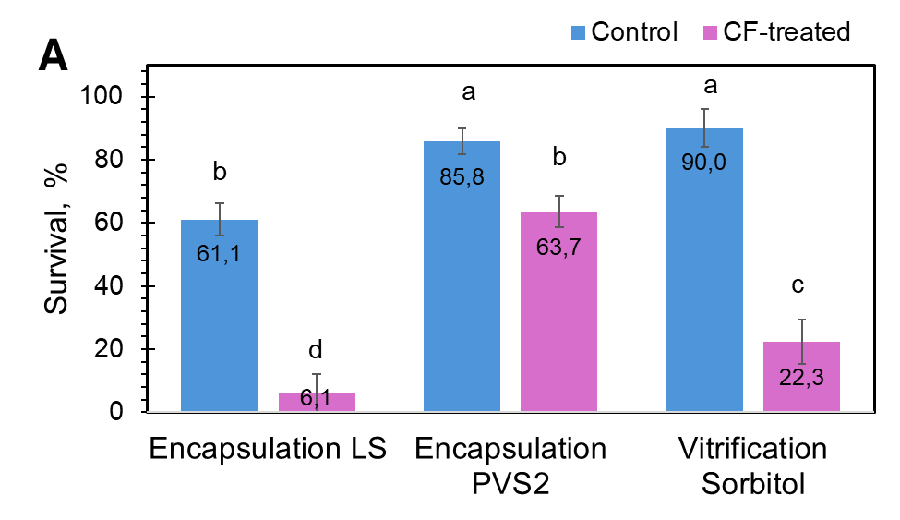
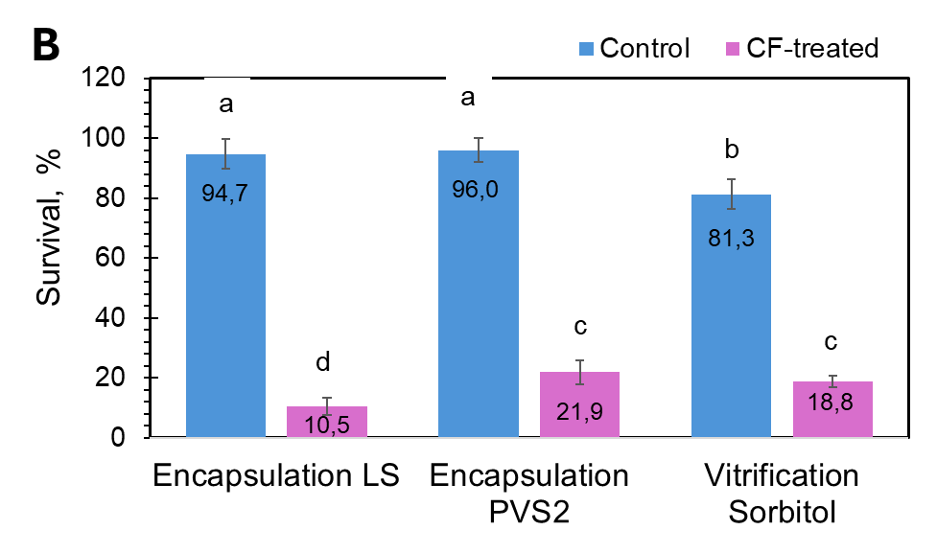
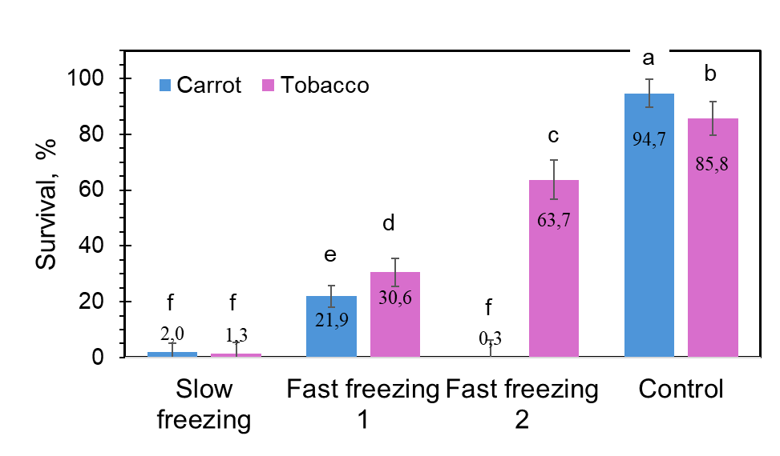
Results and Discussions
Figure 3. Survival rate of (A) Nicotiana tabacum and (B) Daucus carota cv. Ieva CSCs depending on different cryoprotectants and pretreatment technology. Different letters denote significant differences between experimental groups, ANOVA (p ≤ 0.05).
Figure 4. Survival rate of carrot cv. Ieva and GM / non-GM (control) tobacco cv. Samsun-NN CS depending on freezing regime and incubation in PVS2 solution. Different letters denote significant differences between experimental groups, ANOVA (p ≤ 0.05).

Slide 4
Conclusions and Perspectives
63.7% and 21.9% viability of tobacco and carrot CS cells were obtained using the vitrification–encapsulation method with PVS2.
Vitrification method using 0.5M sorbitol and 5% DMSO cryoprotectants for CP of apple cells cv. Gala was better compared to 2M glycerol and 0.4M sucrose or PVS2, but a low viability (11 %) was obtained and it should be improved.
For CP of tobacco cv. Samsun-NN and carrot cv. Ieva CS cells using PVS2 solution, the most suitable was rapid freezing in liquid nitrogen vs slow freezing by sucrose and glycerol as cryoprotectants.
80 min. exposure in 100% PVS2 solution was suitable for CP of GM tobacco cv. Samsun-NN CS cells; therefore, for carrot cv. Ieva CS cells, 40 min. exposure in 50% and 100% PVS2 solutions.
Acknowledgements
Central Project Management Agency (CPMA) project implementation plan (PIP) No. 10-038-T-0100 project „Orchad plant cryopreservation and adaptability increasement”.
This research was partly supported by the Lithuanian Research Council (LRC) instrument No. 01.2.2-LMT-K-718-01-0037 project „Closed plant cultivation technology for the preparation of plant raw materials for peptide nanoengineering applications”.
Students: Šaltenyte I. (VMU, Lithuania), Kežys M. (VMU, Lithuania) for presenting in cryopreservation experiments of cell suspension cultures.

