Slide 1



Impact of granulated biofuel ash on soil and plant nutrients and heavy metals: a three-year study
Dr. Kristina Bunevičienė
kristina.buneviciene@lammc.lt
Co-autor Dr. Donata Drapanauskaitė
June 12, 2025

Slide 2

Why biofuel ash??
Currently, biofuel ash production in Europe exceeds 15.5 million tons per year (Horvatenec et al., 2025), and in 2022, global biofuel ash production reached about 592 million tons. It is also predicted that the annual growth rate will increase by another 6.34% until 2032 (Chemanalyst, 2023). Therefore, the accumulation of biofuel ash is a sensitive and relevant topic not only in Europe, but also worldwide.

Slide 3
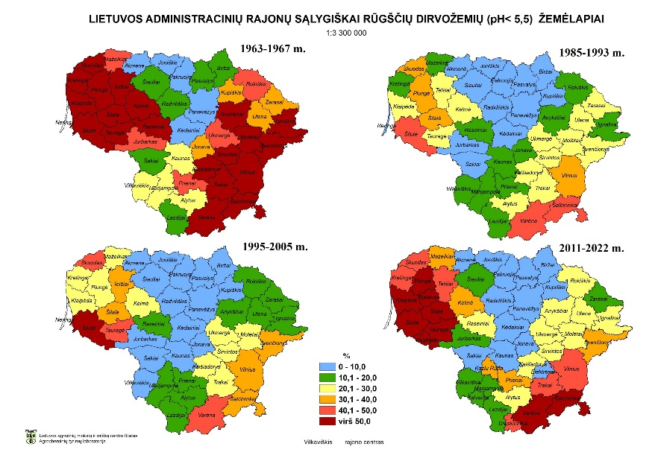
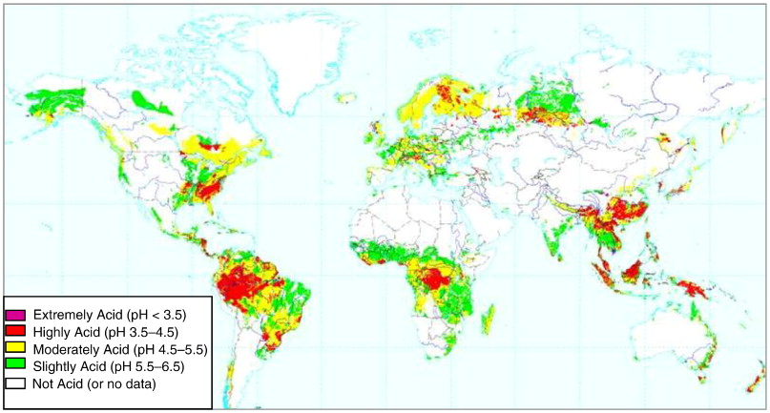
Fig. 1 Soil pH changes in Lithuania (data from the LAMMC Agrochemical Research Laboratory)
Fig. 2 World distribution of acid soils (USDA, NRCS, world soil resources, Washington, D.C.)
Acid soil is a worldwide problem. There are 3950 million hectares of arable land affected by soil acidity. Soil acidification is an ongoing natural process in nature, but it can also be caused by acid rain, leaching of nutrients, the use of physiologically acid fertilizers, and other factors. Approximately 51.0% of East and 66.0% of West Lithuanian agricultural land have surface pH values less than or equal to 5.5. Therefore, such soil should be fertilized with ash and neutralized.

Slide 4
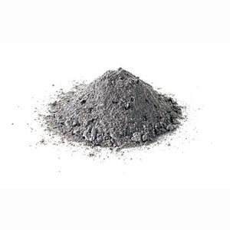
Biofuel ash (BA) is a complex and heterogeneous mixture of inorganic crystalline and amorphous minerals with organic matter (Vassilev et al., 2013a).
  K, P, Ca ir Mg (Freire et al., 2015)
  Cu ir Zn (Dimkpa, Bindraban, 2016)
Fig. 3 Biofuel ash

Slide 5
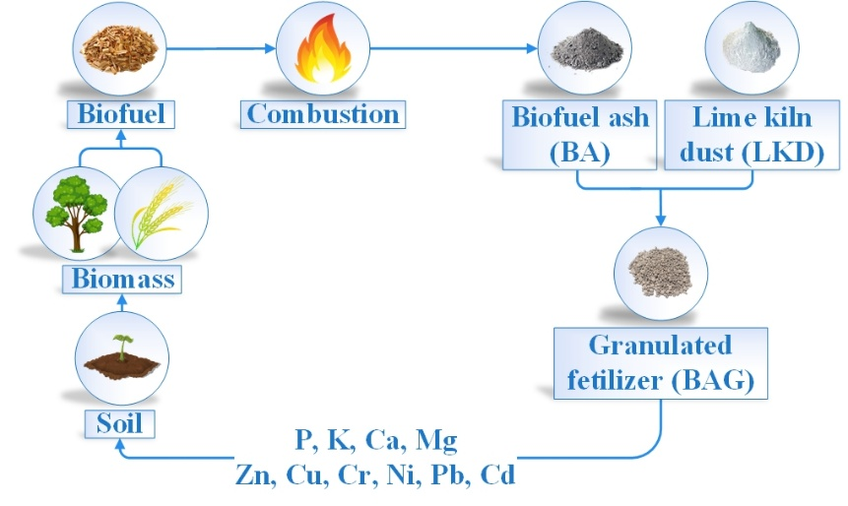
RESEARCH OBJECTIVE
This study aimed to evaluate the effects of biofuel ash (BA) and lime kiln dust (LKD) application on plant productivity over three years, focusing on the release of nutrients and heavy metals from the BA and LKD granules. The primary objective was to conduct a detailed analysis of heavy metal accumulation and mobility in the plants and soil while examining changes in soil nutrient levels.
Fig. 4 Possible recycling and reuse of nutrients from biomass thermochemical combustion ash to replenish the soil without introducing significant amounts of heavy metals

Slide 6
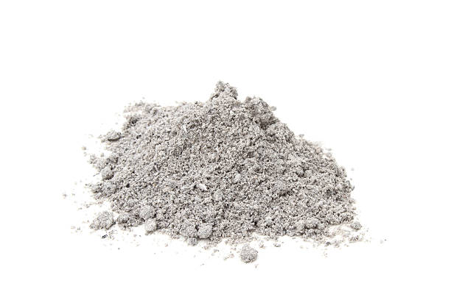
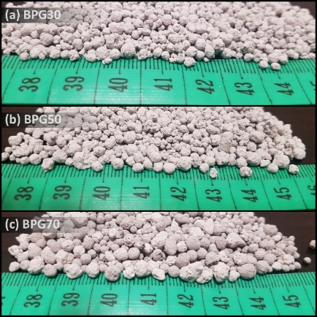
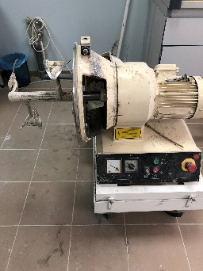
METHODS AND MATERIALS
H₂O
Biofuel ash (BA)
Lime kiln dust (LKD)
Fig. 5 The granulator machine
Fig. 6 Ash granules (a), (b) and (c). The number in the abbreviation represents a mass fraction of biofuel ash in granules
Table 1. The percentage composition of the granules
Bunevičienė, Kristina; Drapanauskaitė, Donata; Mažeika, Romas; Tilvikienė, Vita; Baltrušaitis, Jonas. Granulated biofuel ash as a sustainable source of plant nutrients // Waste Management & Research, Vol. 39, Iss. 6, p. 806-817. DOI: 10.1177/0734242X20948952

Slide 7
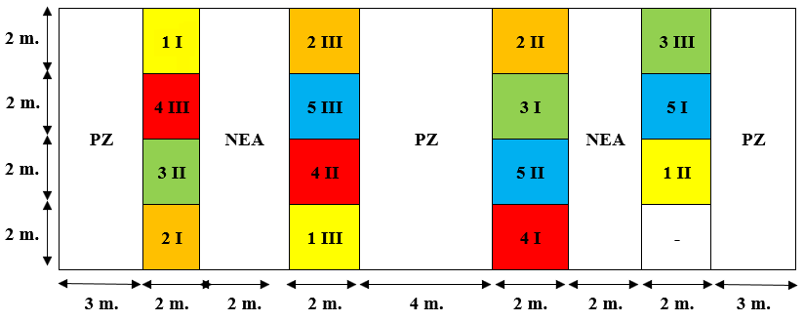
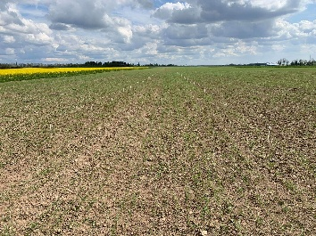
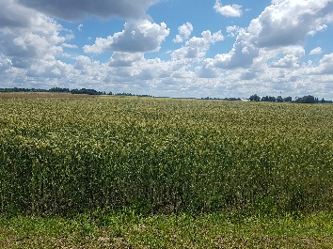
FIELD EXPERIMENT
The field experiment was designed by randomly selecting small plots with a size of 4 m²;
The fertilizing products were broadcast on the surface and incorporated into the 0 – 15 cm layer before the first year's sowing;
It was grown spring wheat (2019), spring triticale (2020), and spring barley (2021).
Fig. 8 Field experiment scheme. 1 – control, 2 – BA, 3 – BAG30, 4 – BAG50, 5 – BAG80. PZ – protection zone; NEA – non-experimental area
Fig. 7 Field in Kėdainiai, Lithuania

Slide 8
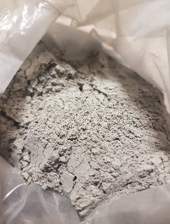
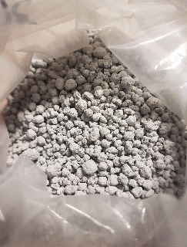
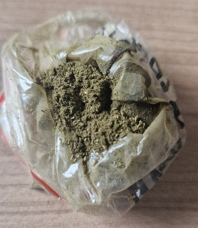
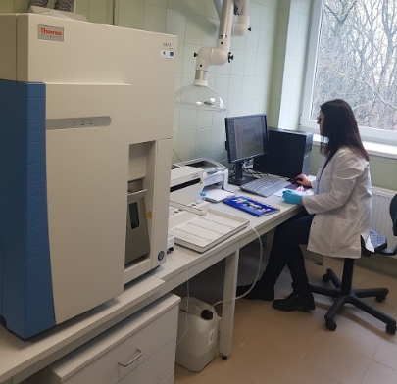
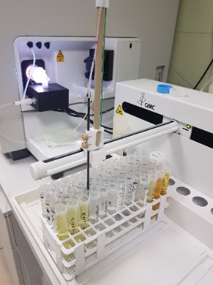
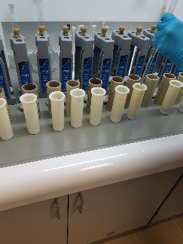
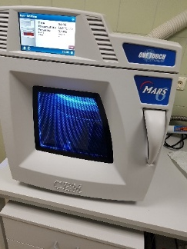
LABORATORY ANALYSIS
Fig. 9. Samples: powder biofuel ash, granular ash, soils, and plants: grains and straw
Fig. 11. The resulting solution is analyzed by inductively coupled plasma mass spectrometry (ICP−MS) (ThermoFisher Scientific, USA)
Heavy metals (Cd, Pb, Cr, Ni, Zn, Cu) and nutrients (K, P, Ca, Mg)
Nutrient balance
Contamination factor (CF) and pollution load index (PLI)
Fig. 10. Sample mineralization with the automatic sample mineralization system MARS6 (CEM, US)

Slide 9
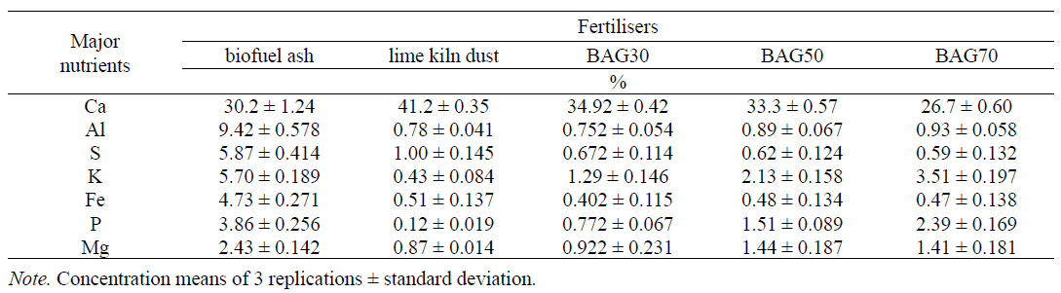
RESULTS (1)
Table 2. Chemical composition of powder biofuel ash, lime kiln dust, and granular fertilizers
Bunevičienė, Kristina; Drapanauskaitė, Donata; Mažeika, Romas; Tilvikienė, Vita. Biofuel ash granules as a source of soil and plant nutrients = Biokuro pelenų granulės – dirvožemio ir augalų maisto medžiagų šaltinis // Žemdirbystė=Agriculture, 2021, Vol. 108, No. 1, p. 19-26.
DOI: 10.13080/z-a.2021.108.003

Slide 10
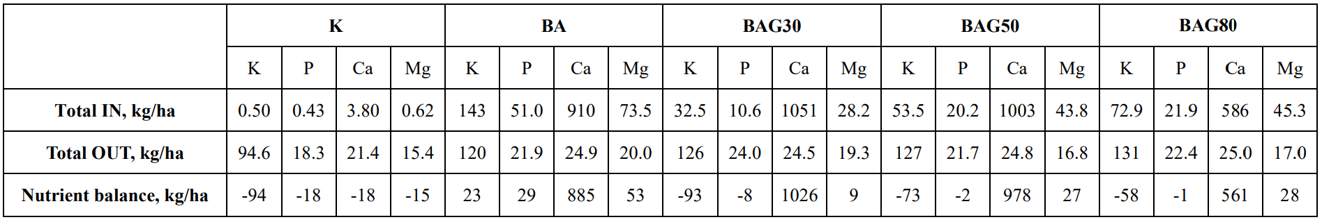
RESULTS (2)
Table 3. Nutrient balance (2019–2021). K – control, BA – biofuel ash, granulated products: BAG30, BAG50, and BAG80

Slide 11
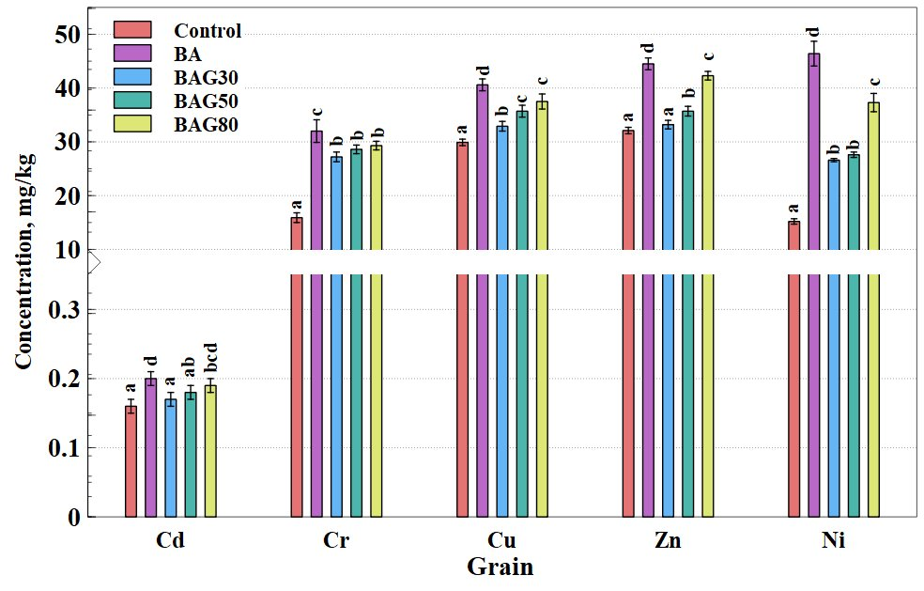
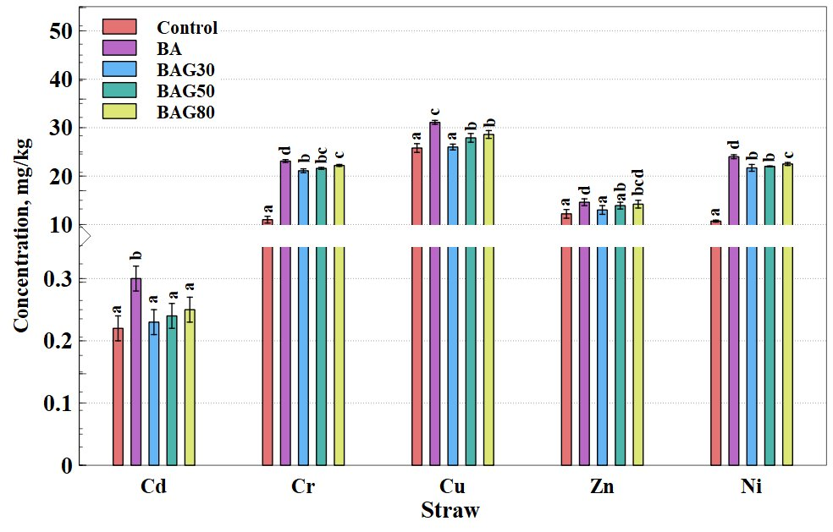
RESULTS (3)
a
b
Fig. 12. Heavy metal concentrations in spring barley grain (a) and straw (b). The difference between values with the same letter was not statistically significant between different fertilization products when P<0.05.

Slide 12
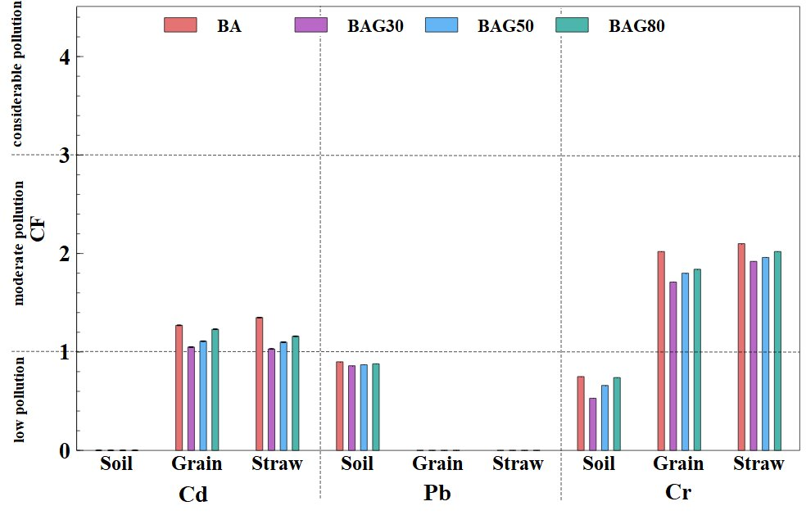
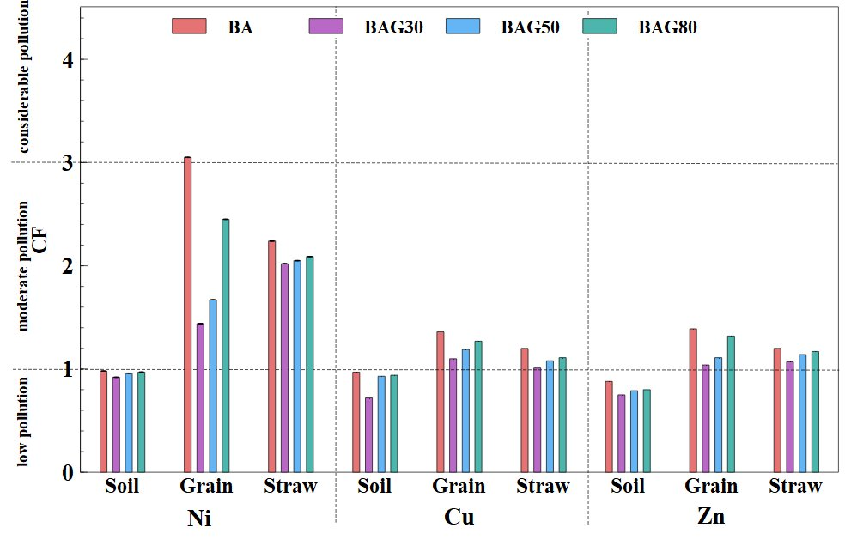
RESULTS (4)
a
b
Fig. 13. Contamination factor (CF): (a) Cd, Pb, and Cr; (b) Ni, Cu, and Zn.

Slide 13
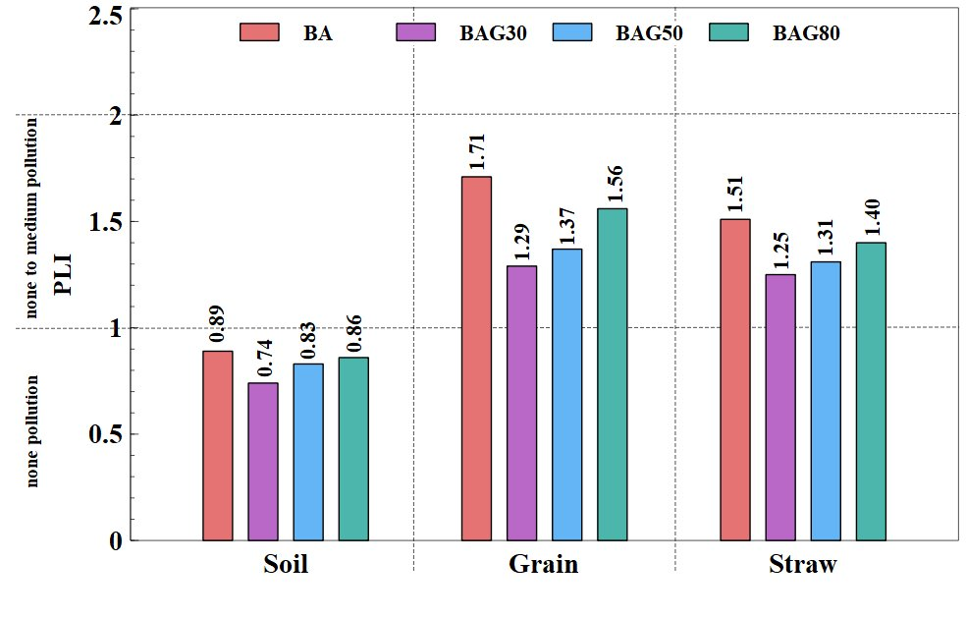
RESULTS (5)
Fig. 14. Pollution load index (PLI) in soil, grain and straw.

Slide 14
CONCLUSIONS
Over the three-year study, fertilizing soil with powder ashes and granules resulted in a positive nutrient balance only for powder ash. As the ash content in the granules increased, the balance of nutrients also improved;
The highest concentrations of heavy metals in grains and straw were observed when fertilizing with BA;
The pollution load index indicated that the straw, grains, and soil had a range from no pollution to medium pollution, confirming that the overall environmental impact of the fertilization treatments was minimal.
Acknowledgement
This study was supported by the long-term research program „Productivity and sustainability agrogenic and forest soils”, implemented by the LAMMC.
The visit was funded by the 2021–2027 EU Funds Investment Programme Economic Recovery and Resilience Measure “Next Generation Lithuania” (NextGenerationEU), project No. 10-038-T-0158.

Slide 15


Lithuanian Research Centre for Agriculture and Forestry
Agrobiology laboratory kristina.buneviciene@lammc.lt https://orcid.org/my-orcid?orcid=0000-0002-6473-0796

