Slide 1


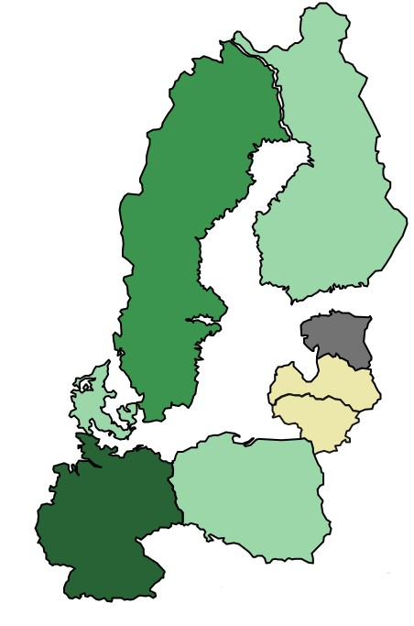
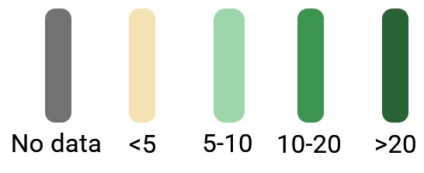
a review on Microplastics in EUROPEAN soil: occurrence, sources, analytical methods, and potential ecological risk
S. Dreskinienė, M. Vilkienė
Lithuanian Research Centre for Agriculture and Forestry, Instituto al. 1, Akademija, 58344 Lithuania
skaiste.dreskiniene@lammc.lt
INTRODUCTION
In North Europe, microplastics are a pervasive issue, as in the rest world. The presence of microplastics in North Europe has raised concerns due to their potential environmental and health impacts. Efforts to address microplastic pollution in North Europe include research initiatives to understand its sources, distribution, and potential ecological risk.
OBJECTIVES
We systematically compare last decade's studies on microplastic pollution in different Baltic Sea region countries (Denmark, Sweden, Finland, Estonia, Latvia, Lithuania, Poland, and Germany).
METHODOLOGY
Research terms were entered to identify relevant scientific papers: microplastic, soil, and selected country. Only the country of the first author was considered.
Figure 2. Published studies amount in every country. The leader is Germany. No available data was found about research done in Estonia.
RESULTS AND DISCUSSION
A total of 66 publications in English were considered relevant to the objectives of this review. 21 of the published papers were reviews.
Figure 1. Published studies for the last decade. More than 89% of the articles were published in the last 5 years.
Figure 3. Mentioned methods for detecting microplastics. Mostly used method was FTIR spectroscopy.
CONCLUSION
After performing the analysis, we observed that there is a lack of information on the regional release of microplastics to agricultural soils, no clear classification of factors affecting the concentration of microplastics in soil, and no observations of possible effects on the environment in the target regions.
Figure 3. Microplastic sources mentioned in publications.

