Slide 1


Biofuel ash use in agriculture: a source of nutrients
The International Symposium on Soil and Plant Analysis
Dr. Donata Drapanauskaitė, G. Žilytė

Slide 2


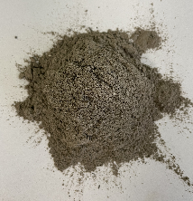


Introduction
18th International Symposium on Soil and Plant Analysis. June 9-13, Durham, NC
Increasing global population
Growing industrialization and urbanization
Rising amount of generated solid waste
Natural resource scarcity
Recover?
Reuse?
Waste
Recycle?
Notes:
As the population increases, together with growing industrialization and urbanization, the amount of generated industrial waste also increases, and the utilization of waste becomes more and more important. Managing solid waste properly is essential because it has a huge influence on our environment and is still a challenge around the world. Strong attention is paid to the nutrients in waste due to natural resource scarcity and if we will not recycle or recover nutrients from waste, they will be lost.

Slide 3
Introduction
18th International Symposium on Soil and Plant Analysis. June 9-13, Durham, NC
N
P
Reuse and recovery/recycling of waste is environmentally friendly
Allows to reduce the use of natural resources
P and K are nonrenewable and becoming progressively limited with supply
Nitrogen (N), phosphorus (P), and potassium (K) are critical to intensive agriculture
K
Notes:
Sustainable handling and reuse of industrial solid waste is a key objective to recycling resources without supplying harmful substances to humans or the environment. Nutrient recovery from waste allows to reduce the use of natural resources, which is critical for P. Also, P and K are predominantly sourced from mineral deposits, and they are nonrenewable and is becoming progressively limited with supply for these certain nutrients. Most of the wastes contains nutrients such as Nitrogen, potassium, and phosphorus, and these nutrients are very important in agriculture.

Slide 4
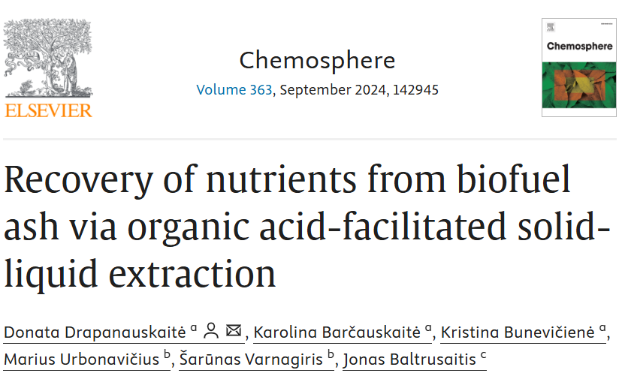
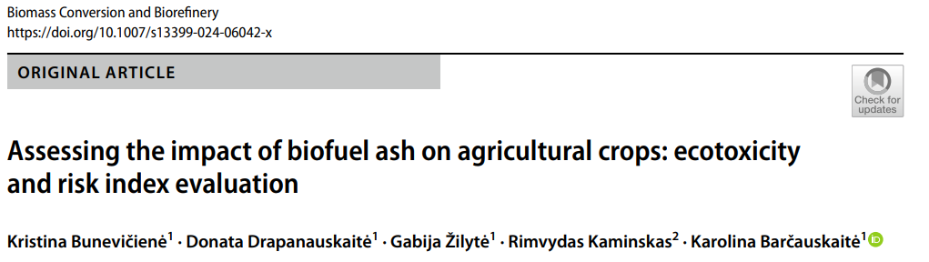
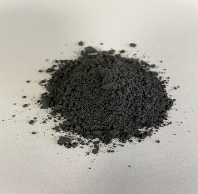
18th International Symposium on Soil and Plant Analysis. June 9-13, Durham, NC
01
02
Granulation
Solid – liquid extraction
Biofuel ash + spent coffee grounds
Biofuel ash
Our work
03
Notes:
Today I will talk about 2 different works which we did using industrial waste. Trying to recover beneficial nutrients from them or using them to produce a fertilizer product.

Slide 5
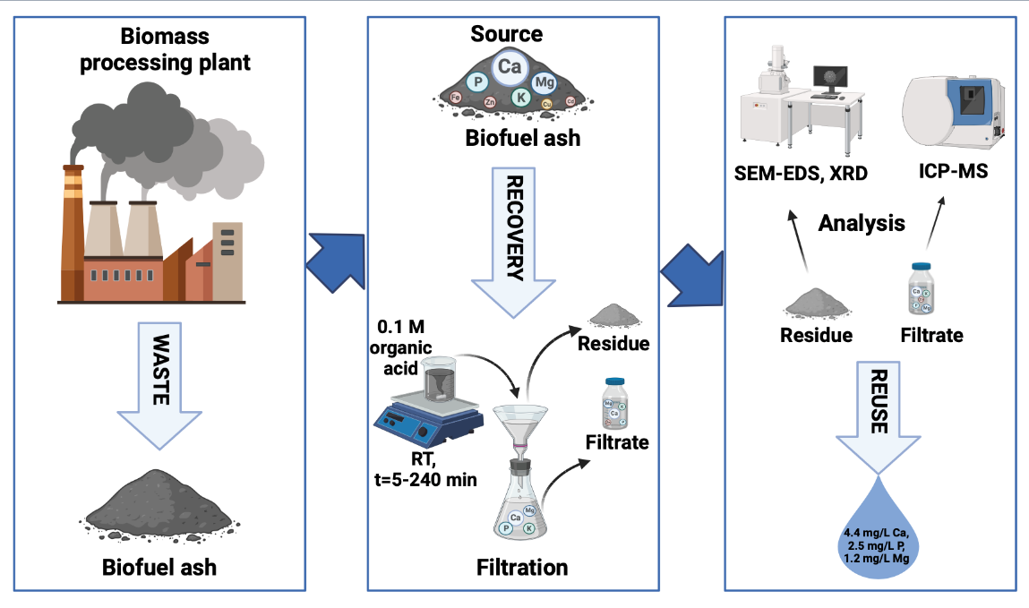
Recovery of nutrients from biofuel ash via organic acid-facilitated solid-liquid extraction
18th International Symposium on Soil and Plant Analysis. June 9-13, Durham, NC
Salicylic acid
Citric acid
Oxalic acid
Drapanauskaitė D., Barčauskaitė K., Bunevičienė K., Urbonavičius M., Varnagiris Š., Baltrusaitis J. 2024. Recovery of nutrients from biofuel ash via organic acid-facilitated solid-liquid extraction. Chemosphere, 363, 142945. https://doi.org/10.1016/j.chemosphere.2024.142945
Notes:
The first study explored the effect of three different organic acids (salicylic acid, citric acid, and oxalic acid) on the recovery of beneficial elements from biofuel ash. The objective of this study was to identify an appropriate leaching agent that optimizes the extraction of beneficial elements while minimizing the leaching of heavy metals. So during this study we used sieved biofuel ash and organic acid solutions to extract beneficial nutrients for plants.

Slide 6
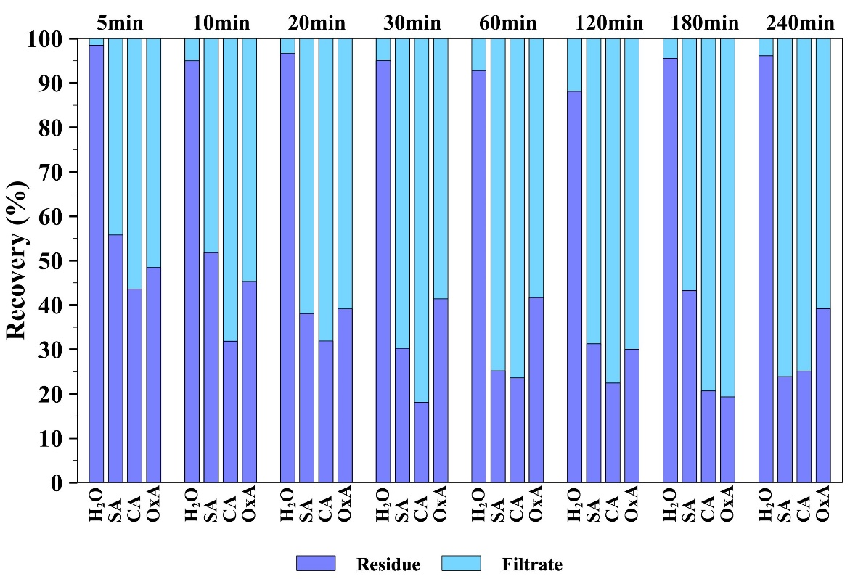
Fertilizers from waste: recovering and reusing nutrients via circular processing of agricultural residues. September 10-12, Lincoln, NE
18th International Symposium on Soil and Plant Analysis. June 9-13, Durham, NC
P
Figure 1. Recovery of P from biofuel ash after extraction with different leaching agents. Note: H₂O deionized water, SA 0.1 M salicylic acid, CA 0.1 M citric acid, OxA 0.1 M oxalic acid
Drapanauskaitė D., Barčauskaitė K., Bunevičienė K., Urbonavičius M., Varnagiris Š., Baltrusaitis J. 2024. Recovery of nutrients from biofuel ash via organic acid-facilitated solid-liquid extraction. Chemosphere, 363, 142945. https://doi.org/10.1016/j.chemosphere.2024.142945
Notes:
Talking about the results of this study, the highest recovery of P (82%) was found in filtrate after extraction with citric acid for 30 min. Also, very similar P recovery results (80.7%) in the filtrate were obtained after using oxalic acid. However, the extraction time was six times longer compared to citric acid.

Slide 7
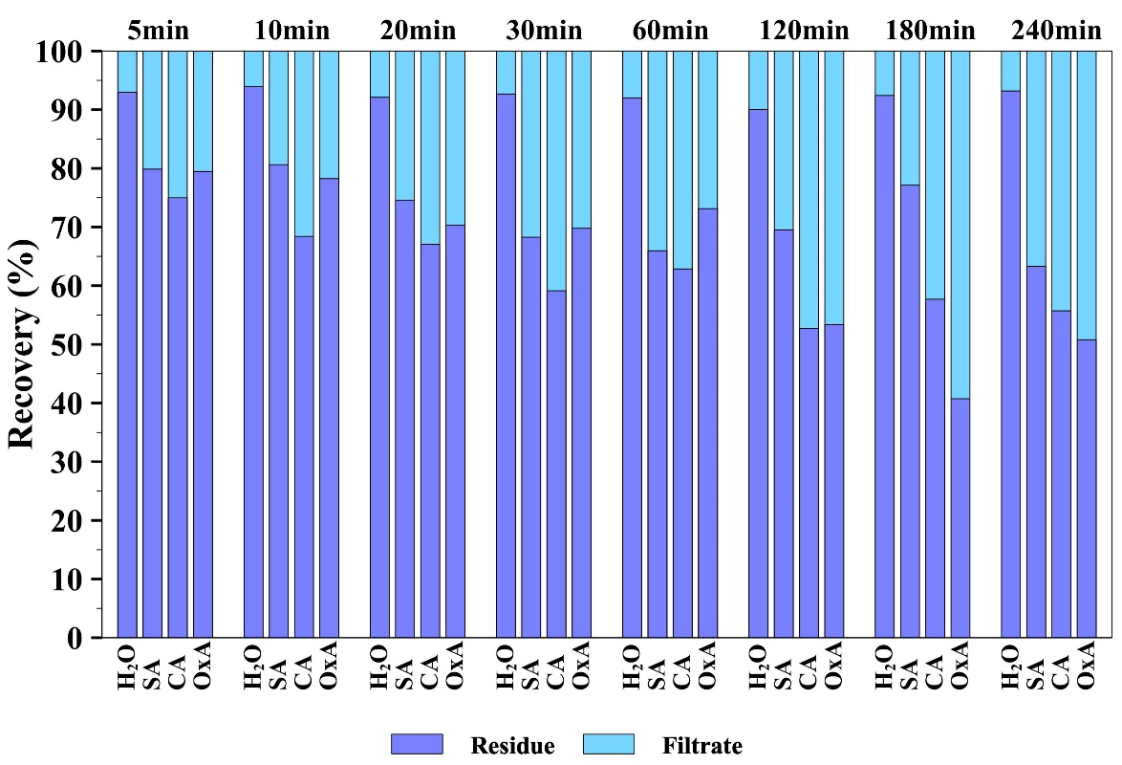
18th International Symposium on Soil and Plant Analysis. June 9-13, Durham, NC
K
Figure 2. Recovery of K from biofuel ash after extraction with different leaching agents. Note: H₂O deionized water, SA 0.1 M salicylic acid, CA 0.1 M citric acid, OxA 0.1 M oxalic acid
Drapanauskaitė D., Barčauskaitė K., Bunevičienė K., Urbonavičius M., Varnagiris Š., Baltrusaitis J. 2024. Recovery of nutrients from biofuel ash via organic acid-facilitated solid-liquid extraction. Chemosphere, 363, 142945. https://doi.org/10.1016/j.chemosphere.2024.142945
Notes:
Taking about the K recovery around 8% of K was recovered from biofuel ash using deionized water, regardless of the duration of the extraction. It shows that a small amount of K in ash is released as water-soluble salts. Using the salicylic acid, the maximum recovery of K was obtained after 60 min and 240 min and it reached 34% and 37%, respectively. The use of citric acid increased the recovery of K to more than 40% after 120 min. However, the highest recovery of K from biofuel ash was determined using oxalic acid at 59% after 180 min.

Slide 8
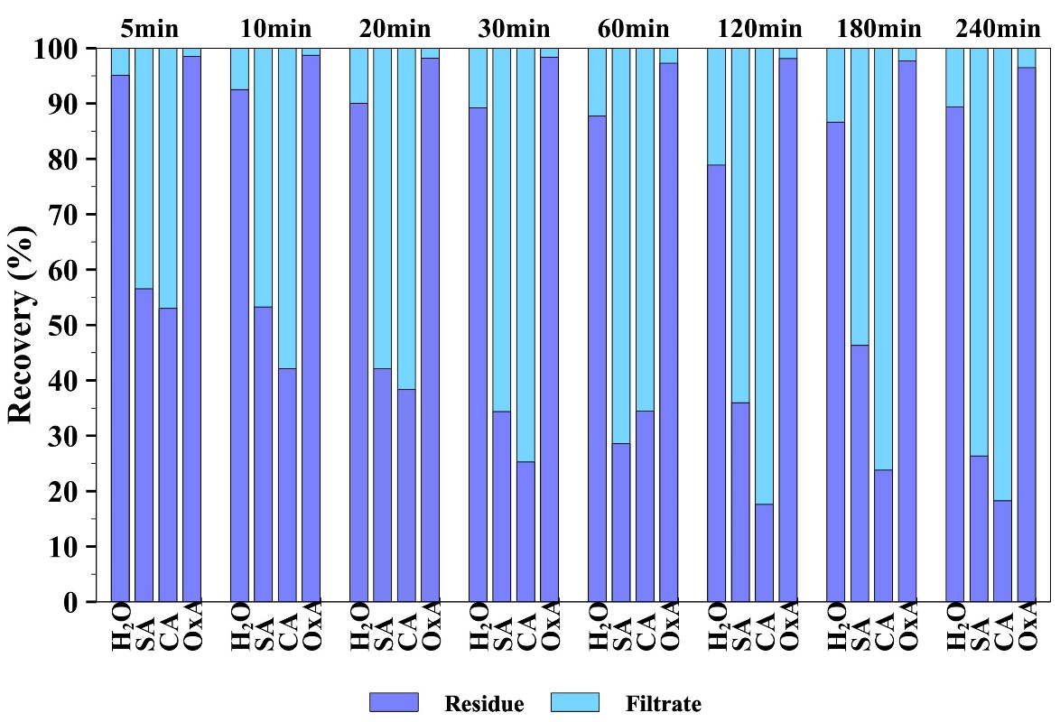
18th International Symposium on Soil and Plant Analysis. June 9-13, Durham, NC
Ca
Figure 3. Recovery of Ca from biofuel ash after extraction with different leaching agents. Note: H₂O deionized water, SA 0.1 M salicylic acid, CA 0.1 M citric acid, OxA 0.1 M oxalic acid
Drapanauskaitė D., Barčauskaitė K., Bunevičienė K., Urbonavičius M., Varnagiris Š., Baltrusaitis J. 2024. Recovery of nutrients from biofuel ash via organic acid-facilitated solid-liquid extraction. Chemosphere, 363, 142945. https://doi.org/10.1016/j.chemosphere.2024.142945
Notes:
The highest Ca recovery was obtained after 120 min with citric acid. The recovery attained 82% of the Ca in the filtrate, and just 18% of Ca remained in the solid phase. Using oxalic acid to recover Ca from biofuel ash will likely result in insoluble calcium oxalates, which later precipitate.

Slide 9
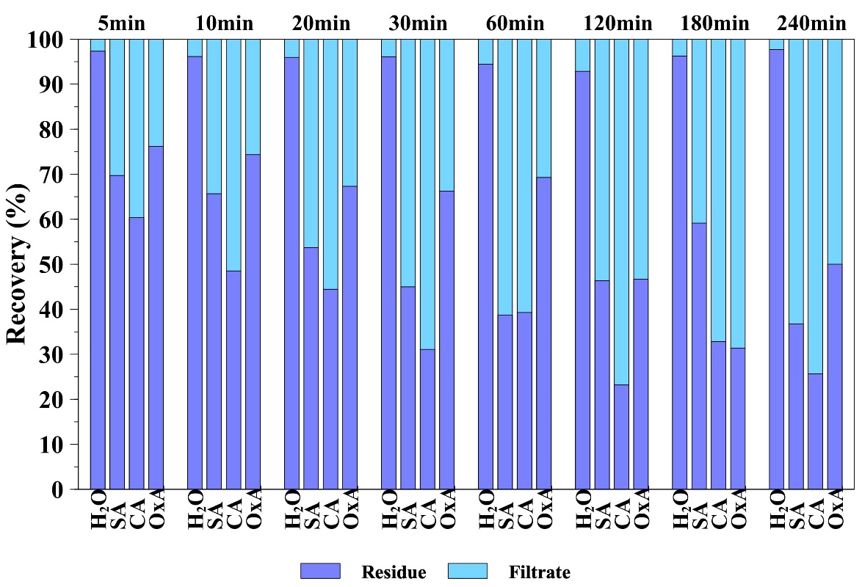
18th International Symposium on Soil and Plant Analysis. June 9-13, Durham, NC
Mg
Figure 4. Recovery of Mg from biofuel ash after extraction with different leaching agents. Note: H₂O deionized water, SA 0.1 M salicylic acid, CA 0.1 M citric acid, OxA 0.1 M oxalic acid
Drapanauskaitė D., Barčauskaitė K., Bunevičienė K., Urbonavičius M., Varnagiris Š., Baltrusaitis J. 2024. Recovery of nutrients from biofuel ash via organic acid-facilitated solid-liquid extraction. Chemosphere, 363, 142945. https://doi.org/10.1016/j.chemosphere.2024.142945
Notes:
The highest Mg recovery of 79% was obtained after 120 min with citric acid treatment. Just about 7% of Mg was recovered from biofuel ash by treating it with deionized water. The Mg recovery from biofuel ash shows the same pattern as Ca. This shows the Mg co-dissolution with Ca. It is likely that Mg is incorporated in biofuel ash in the same compounds as Ca.

Slide 10
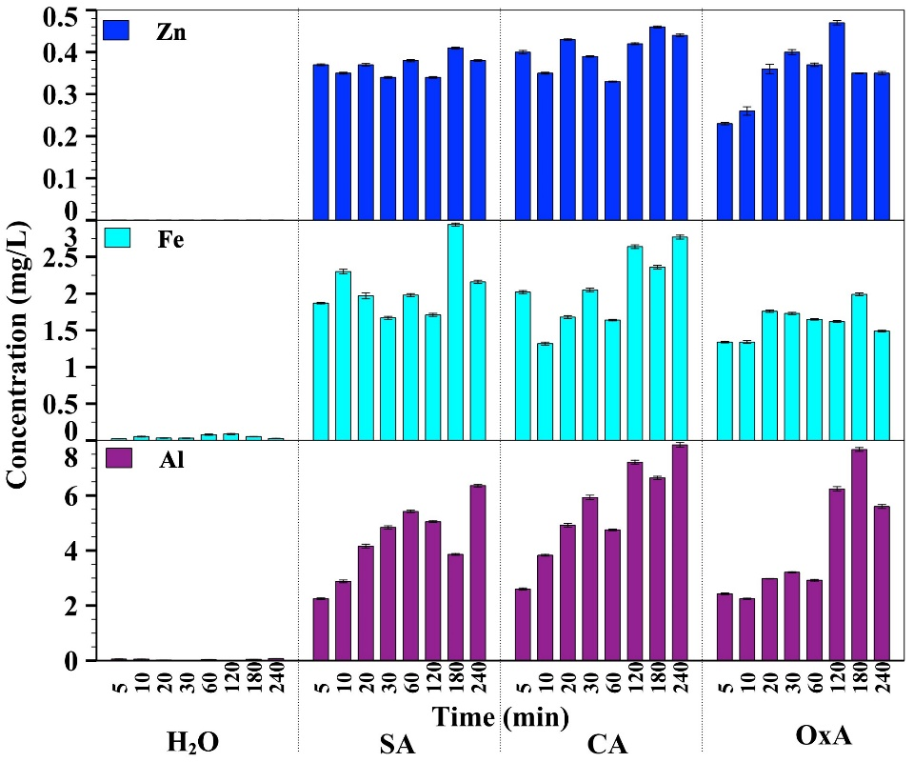
Final remark:
0.1 M citric acid was selected as the optimum leachant for beneficial nutrients (P, K, Ca, Mg).
18th International Symposium on Soil and Plant Analysis. June 9-13, Durham, NC
Figure 5. Recovery of Mg from biofuel ash after extraction with different leaching agents. Note: H₂O deionized water, SA 0.1 M salicylic acid, CA 0.1 M citric acid, OxA 0.1 M oxalic acid
Drapanauskaitė D., Barčauskaitė K., Bunevičienė K., Urbonavičius M., Varnagiris Š., Baltrusaitis J. 2024. Recovery of nutrients from biofuel ash via organic acid-facilitated solid-liquid extraction. Chemosphere, 363, 142945. https://doi.org/10.1016/j.chemosphere.2024.142945

Slide 11
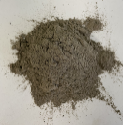
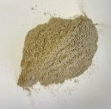
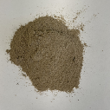
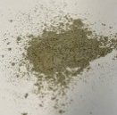
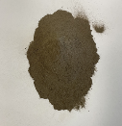
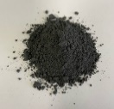
18th International Symposium on Soil and Plant Analysis. June 9-13, Durham, NC
Sustainable use of solid biofuel ash for the production of fertilizers and additional cementitious materials
Suitable for agriculture
Do not exceed MAL of heavy metals
Biofuel ash from electrostatic filter
Biofuel ash from common tank
Suitable for civil engineering
Good CaO/SiO₂ ratio
Biofuel ash from cyclone
For civil engineering and agriculture
Biofuel ash from electrostatic filter
Not suitable for both
Too high CaO/SiO₂ ratio, exceeded MAL of heavy metals
Biofuel ash from common tank
Biofuel ash from common tank
Notes:
Moving on to our second work. The aim of this work was to investigate chemical composition of biofuel ash, which are collected from different spots in industrial plants that uses biomass as an energy source and to identify if they are suitable for fertilizers production or more in use of civil engineering. The biofuel ash was taken directly from cyclone, electrostatic filter and common tank, where they are mixed. After analyzing the chemical composition we determined that biofuel ash, which are taken form cyclone are suitable for fertilizers production, those from common tank are best to use for hydrothermical synthesis of calcium hydro silicates, and the ashes from electrostatic filter was not suitable to use for hydrothermical synthesis due to the high calcium oxside and silicon oxide ratio.

Slide 12
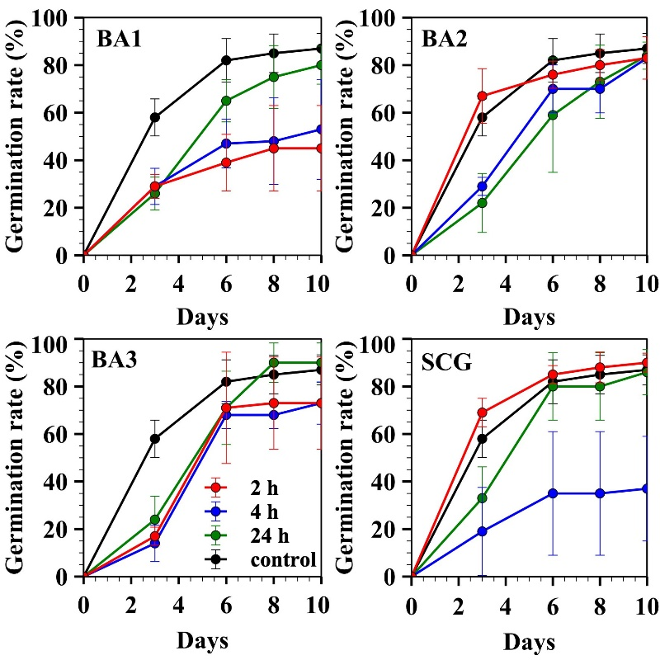
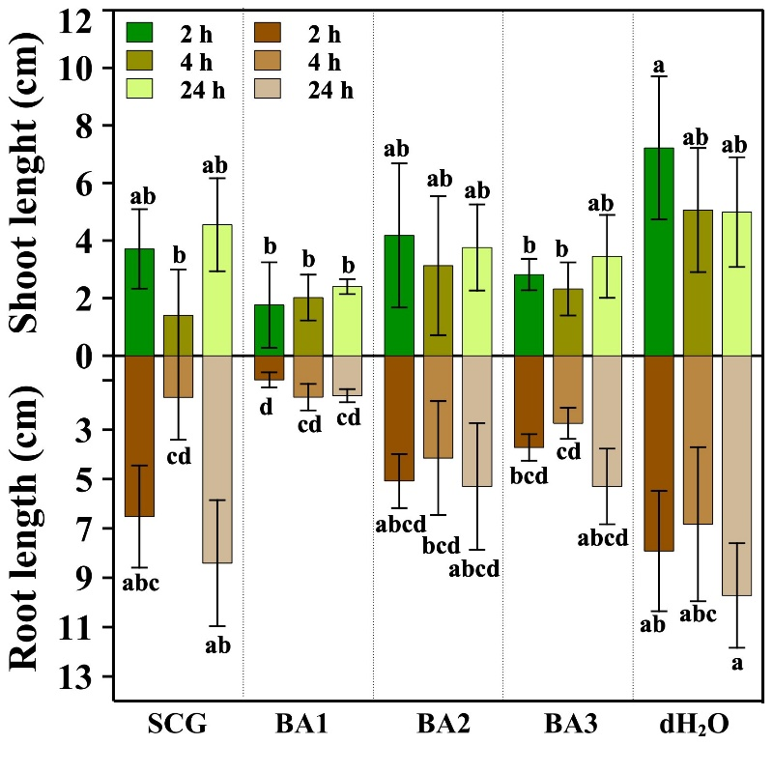
18th International Symposium on Soil and Plant Analysis. June 9-13, Durham, NC
Figure 5. Effect of different biofuel ashes and spent coffee ground leachates on spring wheat germination rate.
Figure 6. Effects of different ashes and spent coffee ground leachates on spring wheat root and shoot length.
Note: BA1-biofuel ash from electrostatic filter, BA2-biofuel ash from cyclone, BA3-biofuel ash from common tank, SCG-spent coffee ground
Bunevičienė K., Drapanauskaitė D., Žilytė G., Kaminskas R., Barčauskaitė K., 2024. Assessing the impact of biofuel ash on agricultural crops: ecotoxicity and risk index evaluation. Biomass Conversion and Biorefinery. https://doi.org/10.1007/s13399-024-06042-x
Notes:
So we tested the biofuel ash ecotoxicity by germinating spring wheat seeds in the extracts prepared from different biofuel ashes. The germination test results showed that the highest germination rate was obtained after 10 days using extracts, which were made from biofuel ashes collected from cyclone. These ashes did not exceed the limits of heavy metals but they were low in nutrients. The most contaminated ashes from electrostatic filter, gave the lowest germination rate. After germination test we measured seeds shoot and root lengths, and for those with lowest germination rate the seedlings lengths were the shortest.

Slide 13
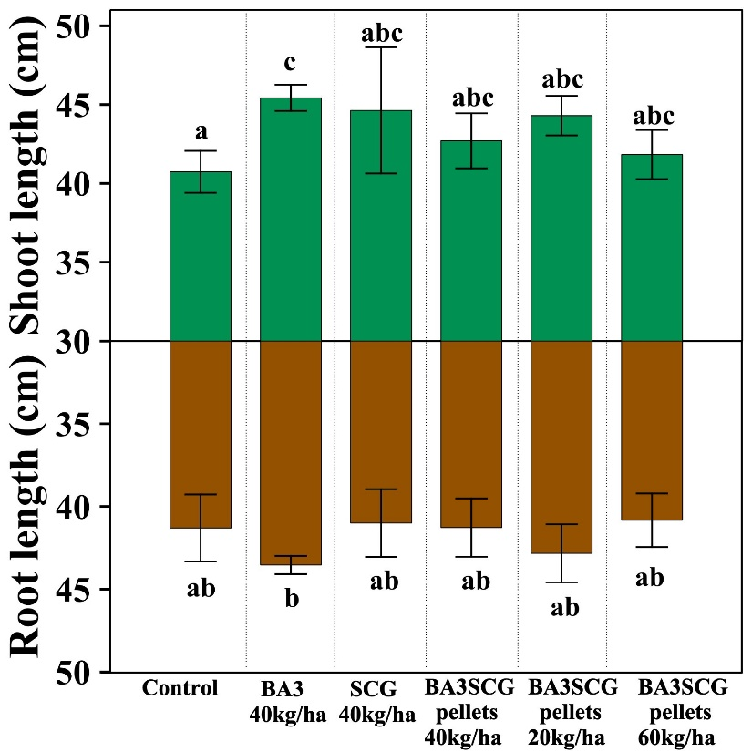
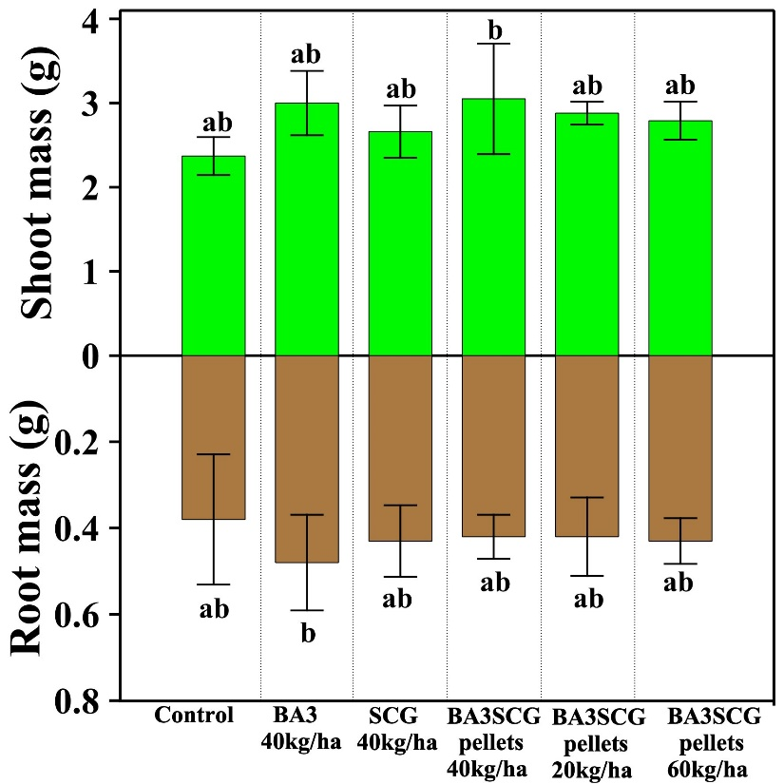

18th International Symposium on Soil and Plant Analysis. June 9-13, Durham, NC
A
B
Figure 8. A Root and shoot length of spring wheat, B Root and shoot mass of spring wheat
Note: BA3-biofuel ash from common tank; BA3SCG-biofuel ash and spent coffee ground pellets
Bunevičienė K., Drapanauskaitė D., Žilytė G., Kaminskas R., Barčauskaitė K., 2024. Assessing the impact of biofuel ash on agricultural crops: ecotoxicity and risk index evaluation. Biomass Conversion and Biorefinery. https://doi.org/10.1007/s13399-024-06042-x
Notes:
Regarding to the chemical composition (high nutrients content and the highest contamination with heavy metals) biofuel ash collected from common tank was chosen for the further testing in pots experiment. And it was decided to check whether it has a positive or negative effect on plant biomass.

Slide 14
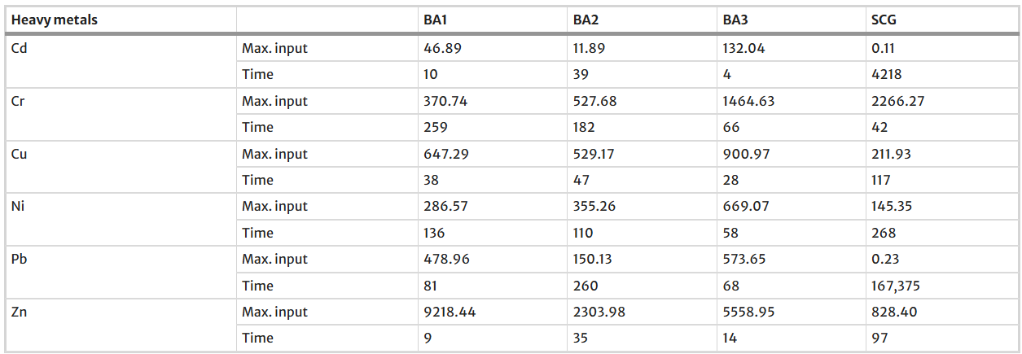
18th International Symposium on Soil and Plant Analysis. June 9-13, Durham, NC
Table 1. Estimated annual maximum inputs of heavy metals (g ha⁻¹ year⁻¹) and time (in years) needed to double heavy metals’ background concentration in soil by continuous application of biofuel ash following phosphorous annual allowable rate (P₂O₅ = 90 mg/kg)
Bunevičienė K., Drapanauskaitė D., Žilytė G., Kaminskas R., Barčauskaitė K., 2024. Assessing the impact of biofuel ash on agricultural crops: ecotoxicity and risk index evaluation. Biomass Conversion and Biorefinery. https://doi.org/10.1007/s13399-024-06042-x
Notes:
Also the annual application rate of BA and SCG input, and the quantity of heavy metal incorporation were calculated based on the annual maximum allowable concentrations according phosphorus, and the results are summarized in this Table. Biofuel ash samples are distinguished by high Zn and Cd toxicity. Estimated predictions indicated that after 4 years of annual application of biofuel ash, which are collected from common tank, the background level of Cd will be doubled, and for Zn it requires 14 years. While using biofuel ash, which are collected from electrostatic filters, only 9 years could be enough to double background levels of Zn, 10 years for Cd. However, the simulation results were somewhat overestimated as the calculations did not factor in trace metal outputs through processes such as leaching, runoff, and crop uptake. Notably, it was proven that SCG did not show any significant contamination risk.

Slide 15
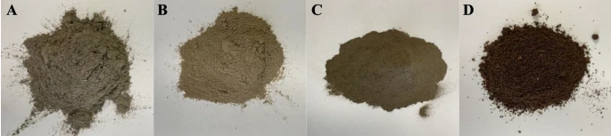
18th International Symposium on Soil and Plant Analysis. June 9-13, Durham, NC
Final remarks:
BA has potential as a soil amendment but should be used with careful monitoring.

Slide 16



Acknowledgement
To my colleagues from Agrobiology laboratory:
Funded by the European Union NextGenerationEU (New Generation Lithuania) project No. 10-038-T-0158.

